Slide 1
Chapter 6 review slides

Slide 2
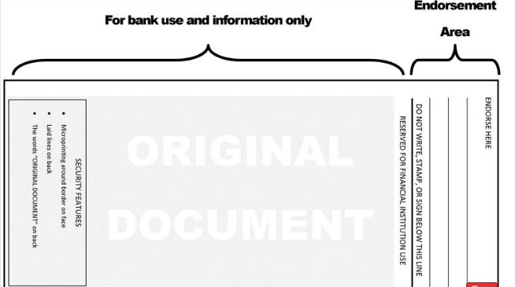
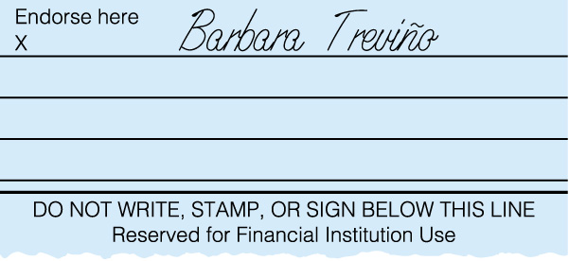
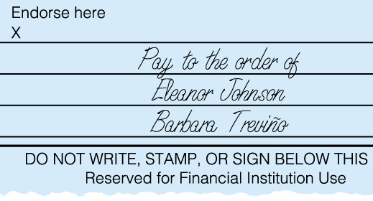
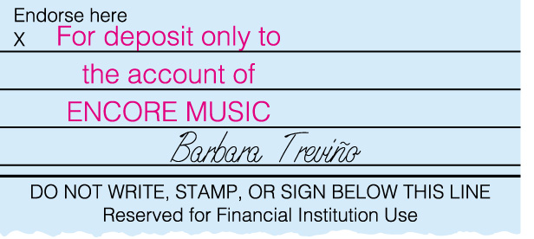
BLANK ENDORSEMENT, SPECIAL ENDORSEMENT, AND RESTRICTIVE ENDORSEMENT
Blank Endorsement
Special Endorsement
Restrictive Endorsement
Lesson 6-1, page 127

Slide 3
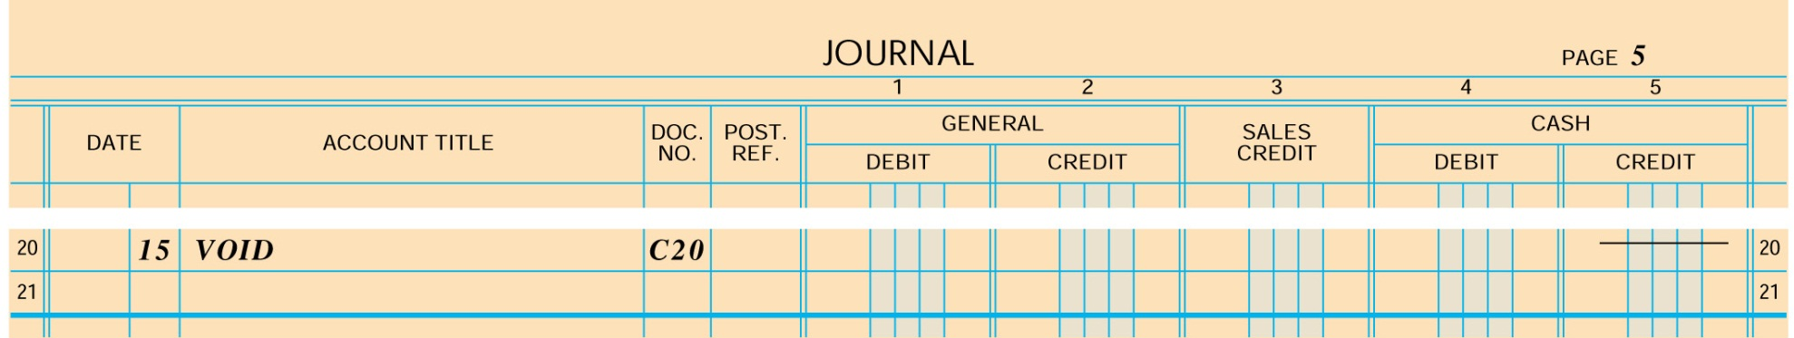
RECORDING A VOIDED CHECK
✓
4
1
2
3
5
1. Record the date.
2. Write the word VOID in the account title.
3. Write the check number.
4. Place a check mark in the Post. Ref. column.
5. Place a dash in the Cash Credit column.
Lesson 6-1, page 129

Slide 4
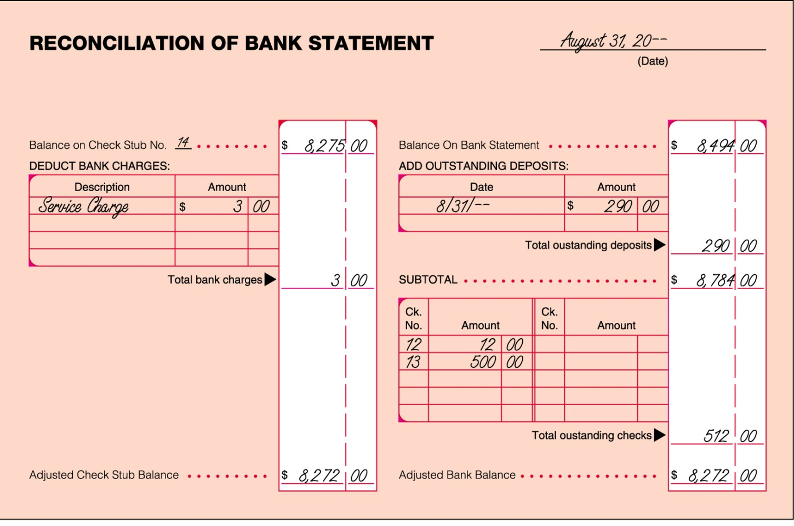
BANK STATEMENT RECONCILIATION
1. Date
1
2. Check Stub Balance
2
5
3. Service Charge
3
6
4. Adjusted Check Stub Balance
7
8
5. Bank Statement Balance
6. Outstanding Deposits
9
4
10
7. Subtotal
8. Outstanding Checks
9. Adjusted Bank Balance
Lesson 6-2, page 132
10. Compare Adjusted Balances

Slide 5
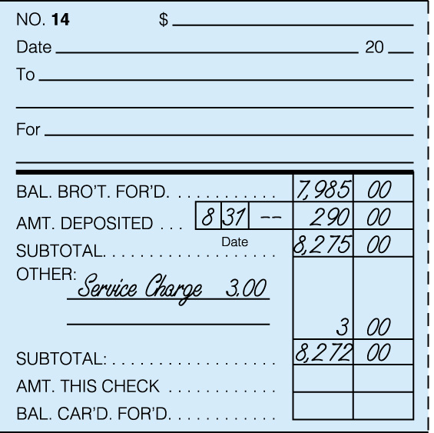
RECORDING A BANK SERVICE CHARGE ON A CHECK STUB
1. Write Service Charge.
2. Write the amount of the service charge.
3. Calculate and record the new subtotal.
1
2
3
Lesson 6-2, page 133

Slide 6
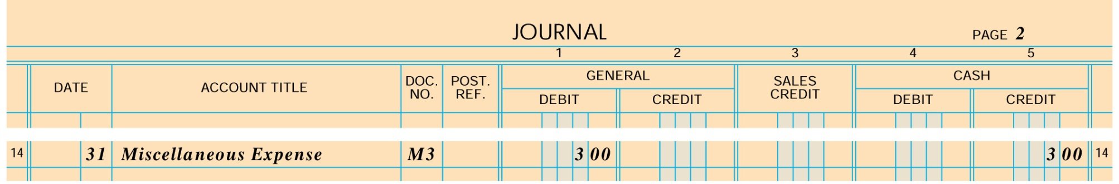
JOURNALIZING A BANK SERVICE CHARGE
1
2
4
3
1. Write the date.
2. Debit Miscellaneous Expense.
3. Credit Cash.
4. Write the source document number.
Lesson 6-2, page 134

Slide 7
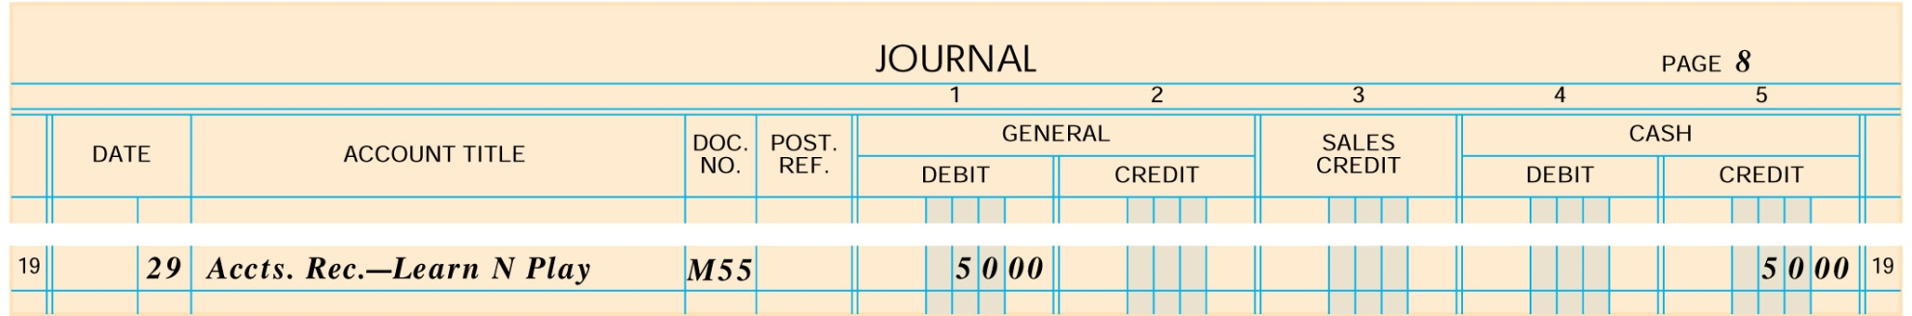
JOURNALIZING A DISHONORED CHECK
4
3
1
2
1. Write the date.
2. Debit Accounts Receivable—Learn N Play.
3. Credit Cash.
4. Write the source document number.
Lesson 6-3, page 137

Slide 8
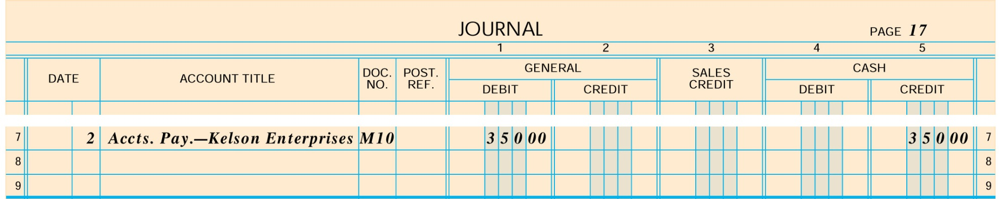
JOURNALIZING AN ELECTRONIC FUNDS TRANSFER
3
1
4
2
1. Write the date.
2. Debit Accounts Payable—Kelson Enterprises.
3. Credit Cash.
4. Write the source document number.
Lesson 6-3, page 138

Slide 9
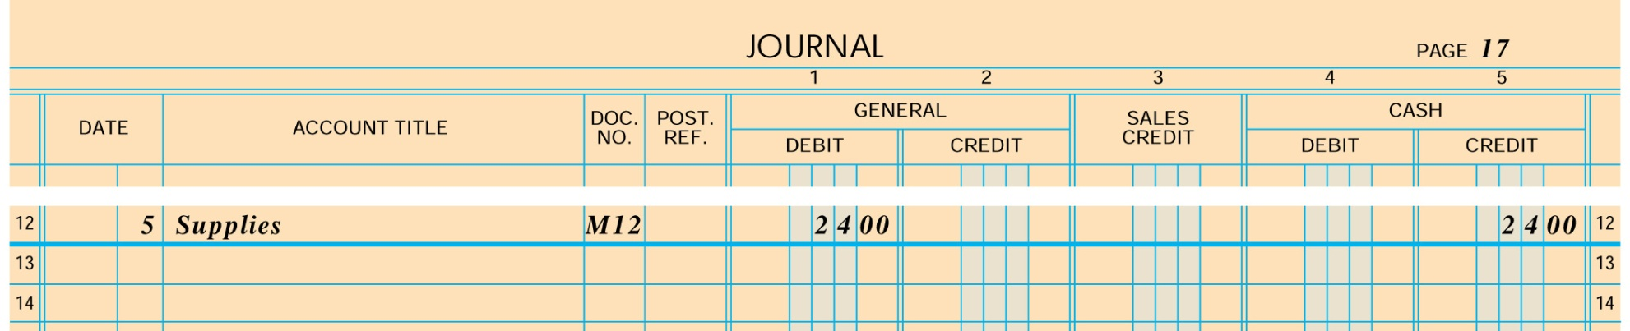
JOURNALIZING A DEBIT CARD TRANSACTION
3
4
1
2
1. Write the date.
2. Debit Supplies.
3. Credit Cash.
4. Write the source document number.
Lesson 6-3, page 139

Slide 10
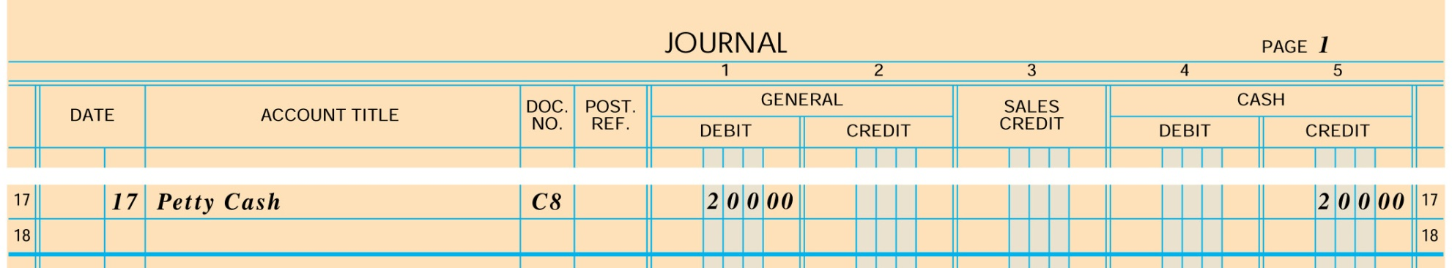
ESTABLISHING A PETTY CASH FUND
4
3
1
2
1. Write the date.
2. Debit Petty Cash.
3. Credit Cash.
4. Write the source document number.
Lesson 6-4, page 141

Slide 11
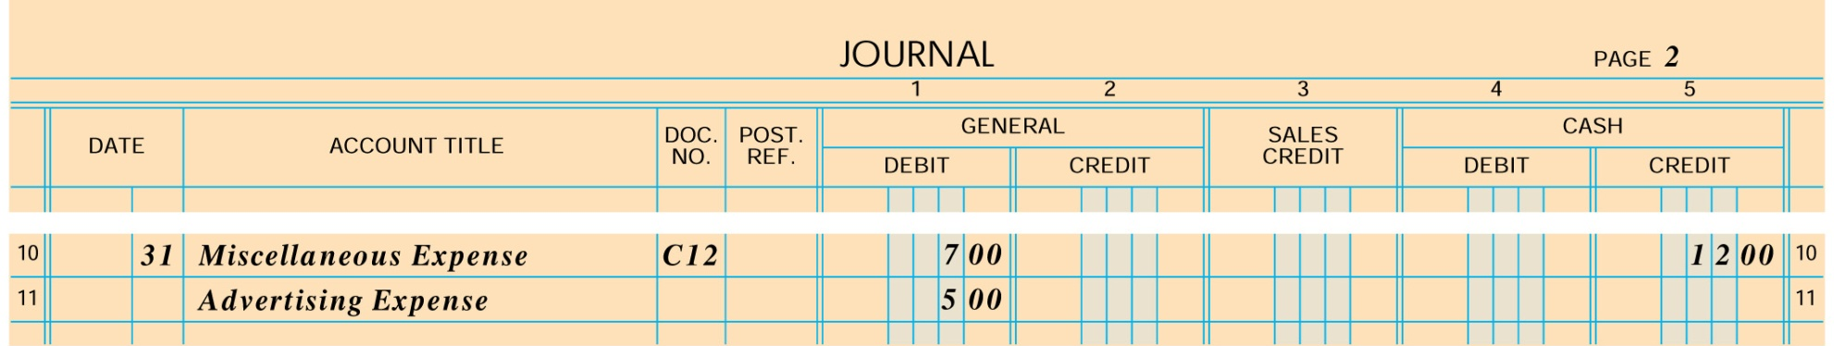
REPLENISHING PETTY CASH
4
3
1
2
1. Write the date.
2. Debit Miscellaneous Expense and Advertising Expense.
3. Credit Cash.
4. Write the source document number.
Lesson 6-4, page 143

