Slide 1
Chapter 14 Review-Mastery

Slide 2
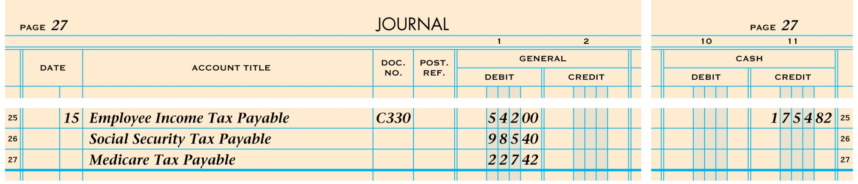
Paid cash for liability for employee income tax, social security tax, Medicare tax:

Slide 3
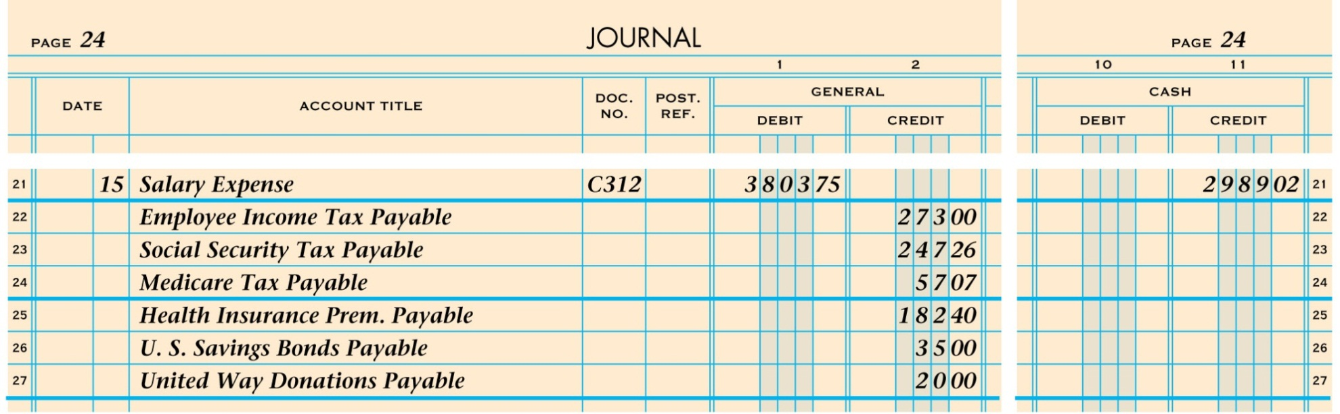
Paid Cash for semimonthly payroll Total payroll, less deductions.
(from payroll register-Employee Side)

Slide 4
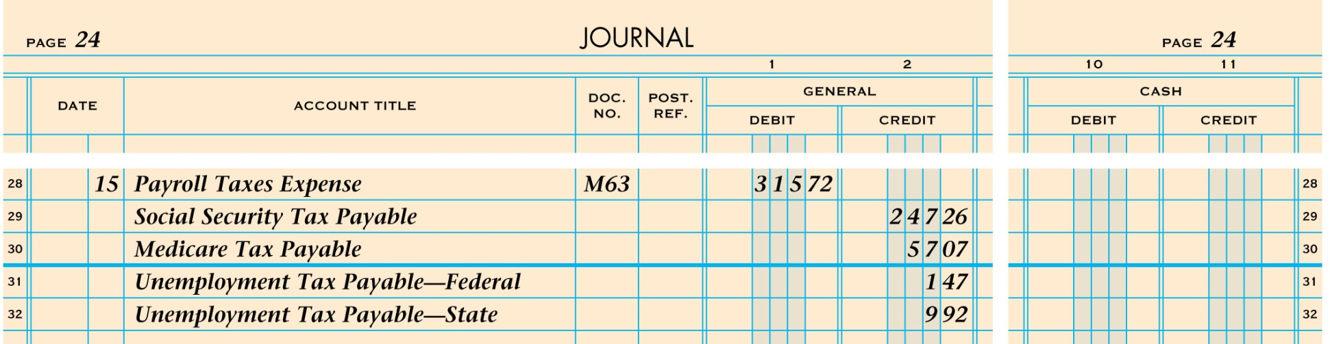
Recorded employer payroll taxes expense. (Employer Side)
Medicare and Social Security is the same amounts as the employee portion
Unemp. Tax Pay Fed. (.8% of the Salary Expense)
Unemp. tax Pay State (5.4% of the Salary Expense)

