Slide 1
Final Exam Review
Accounting I

Slide 2
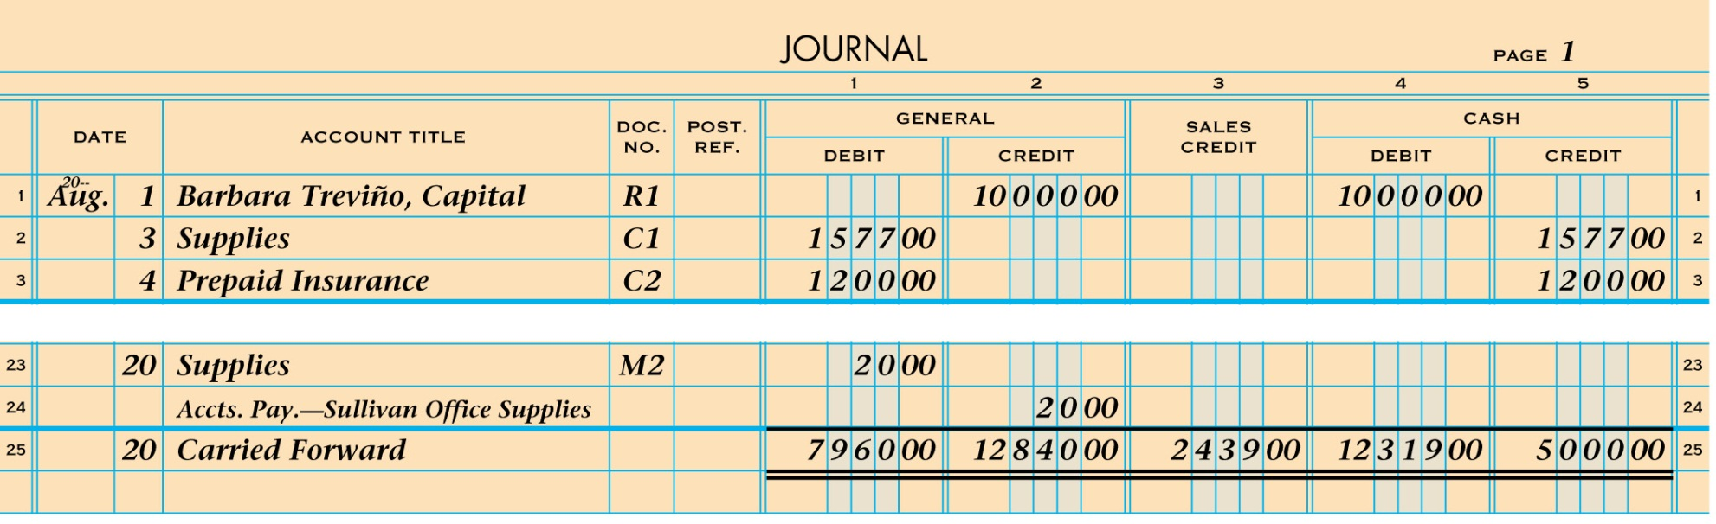
RULING A JOURNAL PAGE
1
5
2
3
4
1. Rule a single line.
2. Write the date.
3. Write Carried Forward.
4. Write each column total.
5. Rule double lines.
Lesson 4-4, page 83

Slide 3
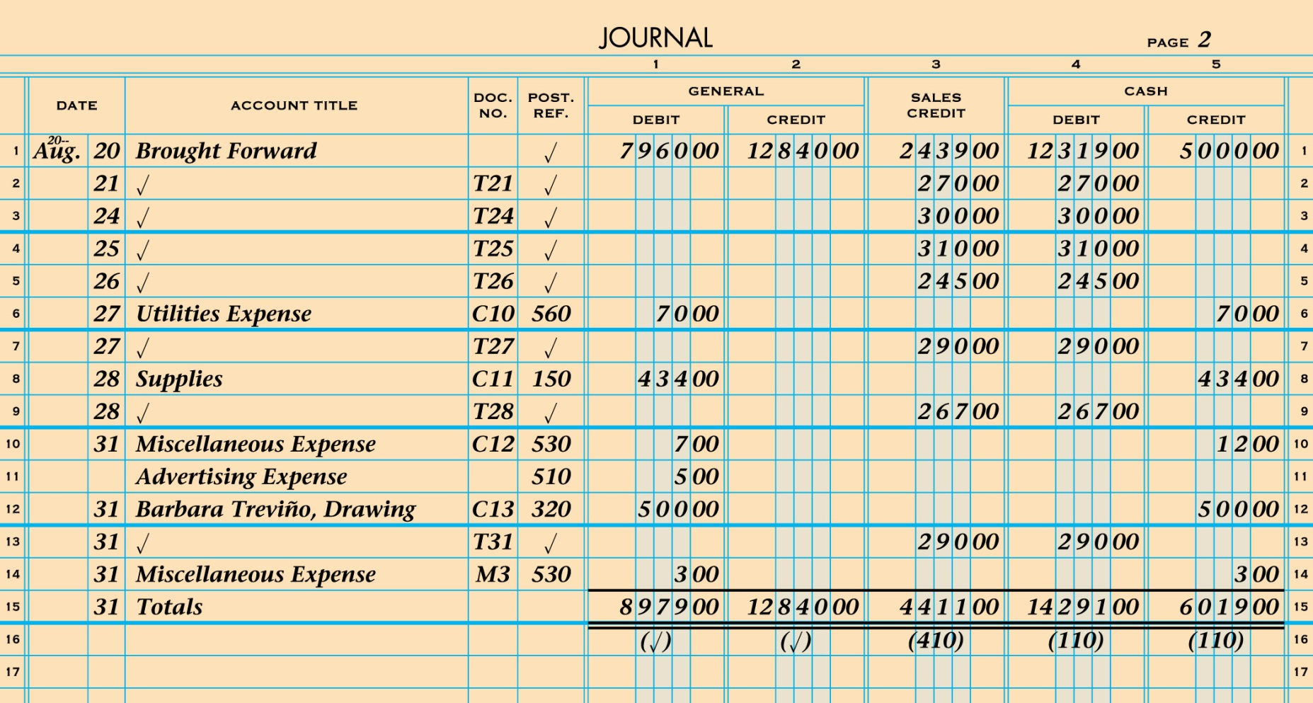
JOURNAL PAGE WITH POSTING COMPLETED
Lesson 5-4, page 112

Slide 4

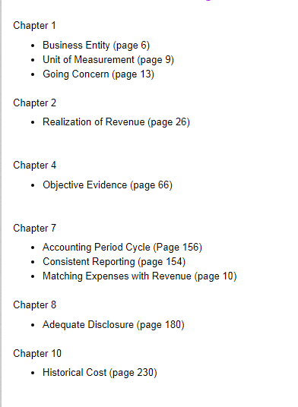

Slide 5
Chapter Vocabulary
Chapter 9
Adjusting entries
Permanent accounts
Temporary accounts
Closing entries
Post-closing trial balance
Accounting cycle

Slide 6
Chapter Vocabulary
Chapter 10
Partnership partner
Merchandising business
Retail merchandising business
Merchandise
Wholesale merchandising business
Mark up
Vendor
Purchase invoice
Terms of sale

Slide 7
Chapter Vocabulary
Chapter 12
Subsidiary ledger
Accounts payable ledger
Accounts receivable ledger
Controlling account
Schedule of accounts payable
Schedule of accounts receivable
Chapter 11
Customer
Sales tax
Cash sale
Credit card sale

Slide 8
Chapter Vocabulary
Chapter 13
Tax base
Payroll register
Net pay
Employee earnings record
Gross Pay
Salary
Pay period
Payroll
Total earnings
Payroll taxes
Withholding allowance
Social security tax
Medicare tax

Slide 9
Chapter Vocabulary
Chapter 15
Inventory
Merchandise inventory
Chapter 14
Federal unemployment tax
State unemployment tax

Slide 10

Chapter 9
Recording Adjusting and Closing Entries for a Service Business.

Slide 11
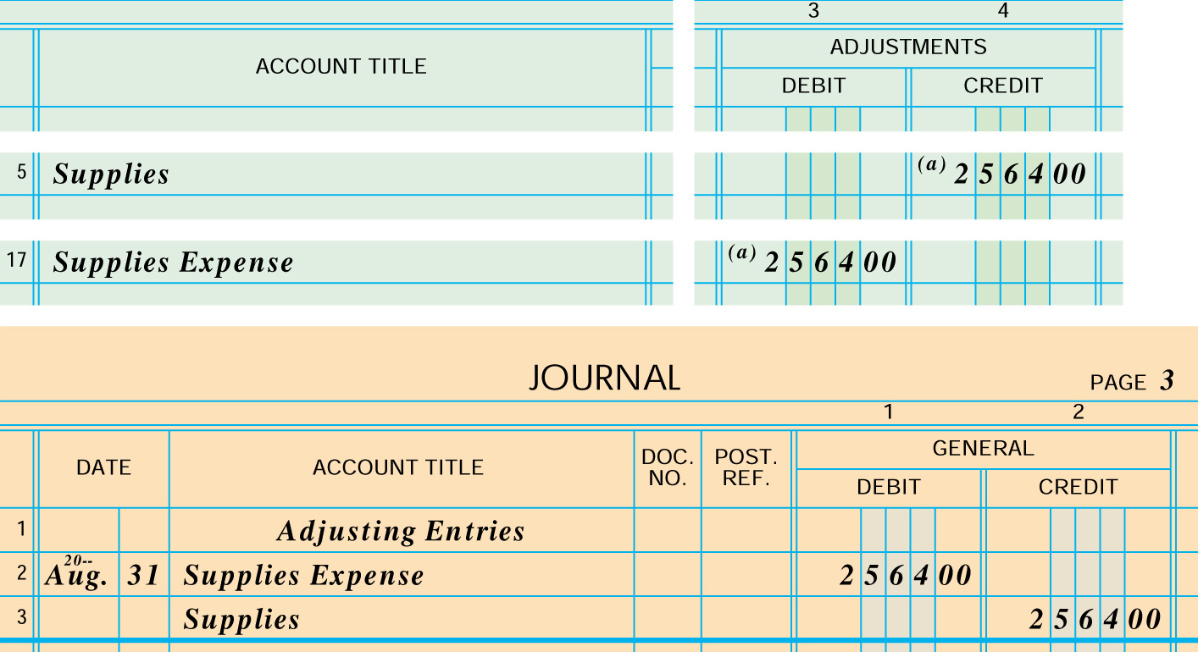
ADJUSTING ENTRY FORADJUSTING ENTRY FOR SUPPLIES
3
2
1
4

Slide 12
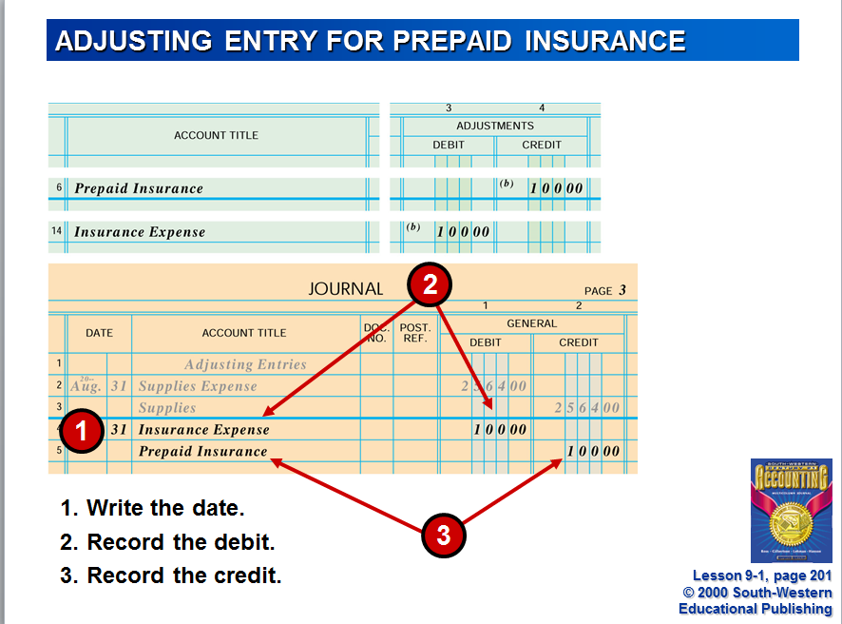

Slide 13
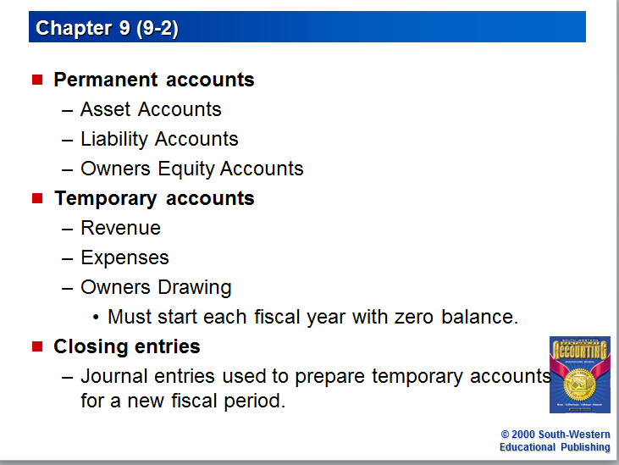

Slide 14
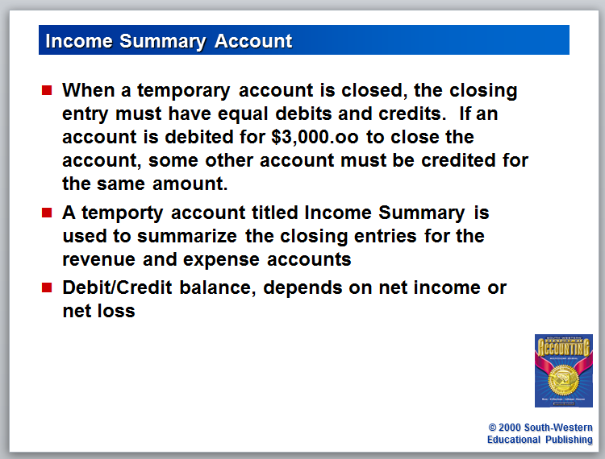

Slide 15
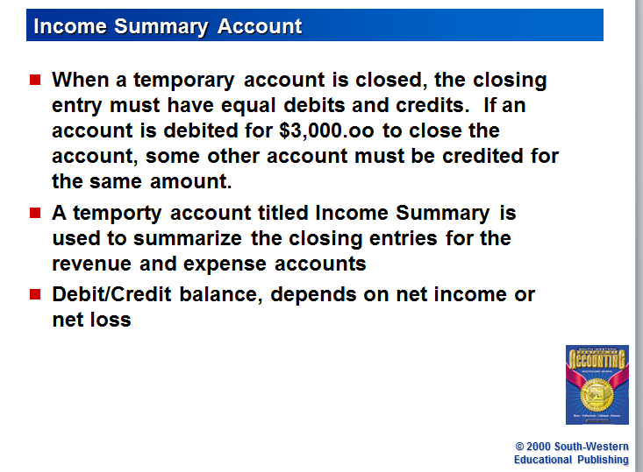

Slide 16
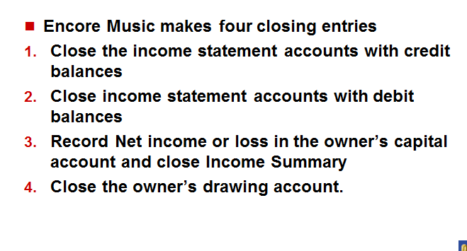

Slide 17
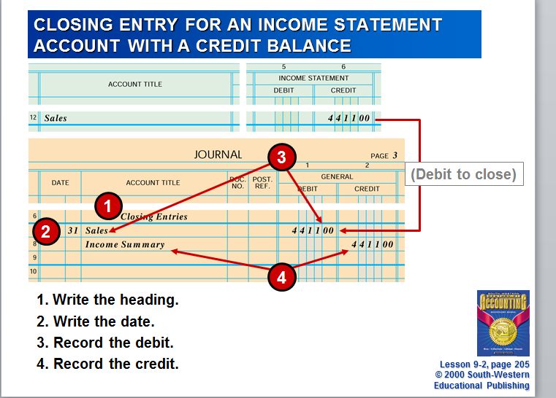

Slide 18
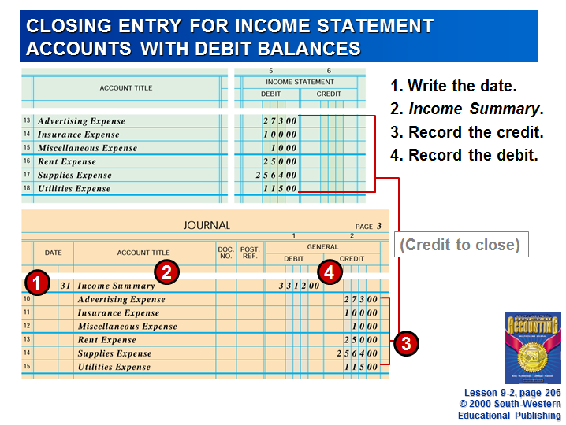

Slide 19
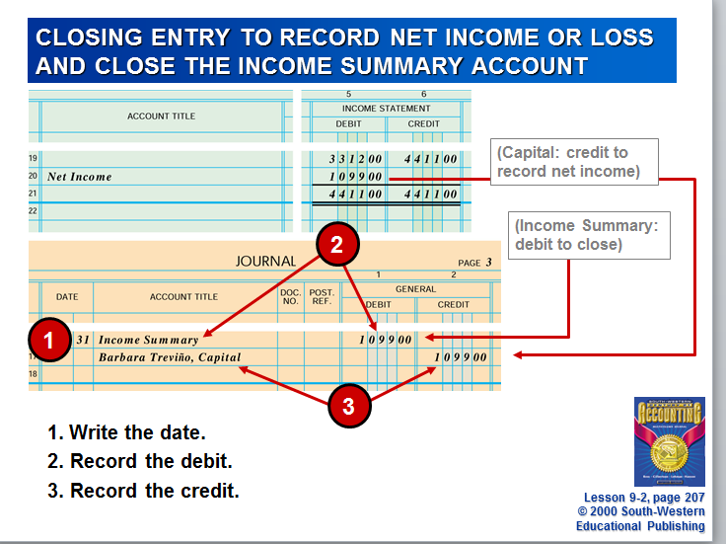

Slide 20
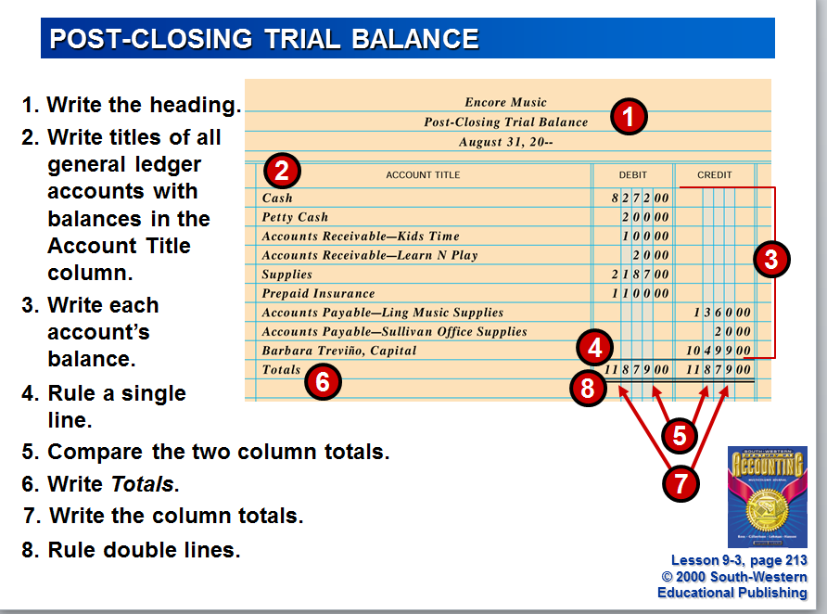

Slide 21
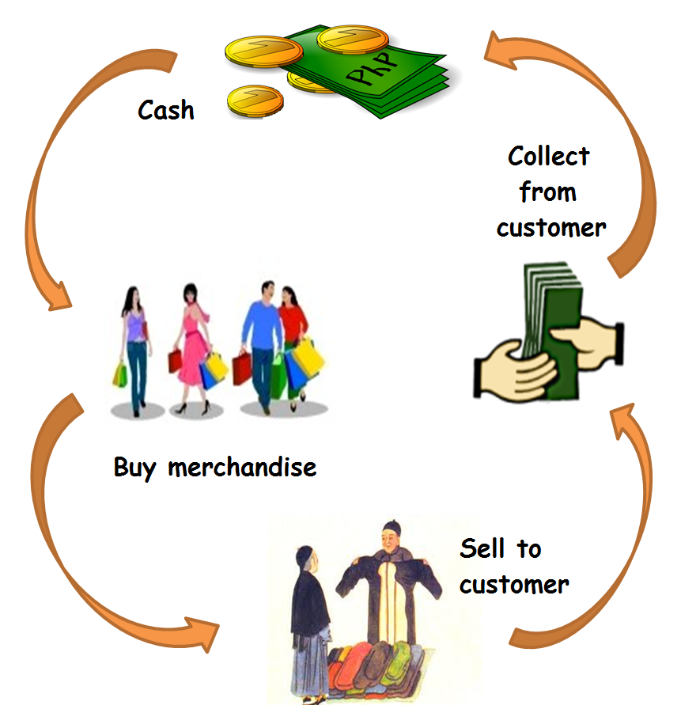

Accounting for a Merchandising Business Organized as a Partnership

Slide 22
Company:Omni Import

Slide 23
Overview:
Chapter 10
  Journalizing purchases and cash payments
Chapter 11
  Journalizing sales and cash receipts
Chapter 12
  Posting to general and subsidiary ledgers (accounts payable and accounts receivable)
Chapter 13
  Preparing Payroll Records
Chapter 14
  Payroll Accounting, Taxes, and Reports
Chapter 15
  Worksheet for A Merchandising Business
Chapter 16
  Financial Statements for a Partnership

Slide 24

Page 226
Partnership- A business in which two or more persons combine their assets and skills
Partner – a member of the partnership

Slide 25

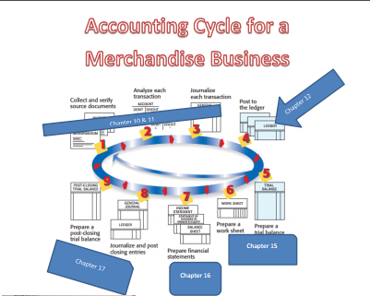

CHAPTER 10
Journalizing Purchases and Cash Payments

Slide 26
Omni Import- Service Business-sells a service for a fee.
They purchase and sell novelty and gift items.
Wholesale Merchandising Business-a business that buys and resells merchandise to retail merchandising businesses.
Merchandise Business-a business that purchases and sells goods
Retail Merchandising Business- sells to people who use or consume goods.

Slide 27
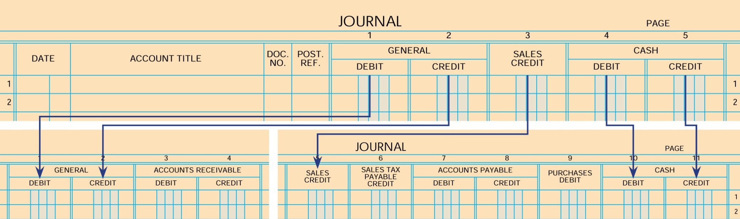
EXPANDED JOURNAL
Lesson 10-1, page 229

Slide 28
Page 230
Cost of merchandise- a price a business pays for goods it purchases and sells
Markup- the amount added to the cost of merchandise to establish the selling price
  An item costs $10.00 and you sell it for 25.00, the mark up is $15.00
Vendor-a business from which merchandise is purchased or supplies or other assets are bought is called a vendor.

Slide 29
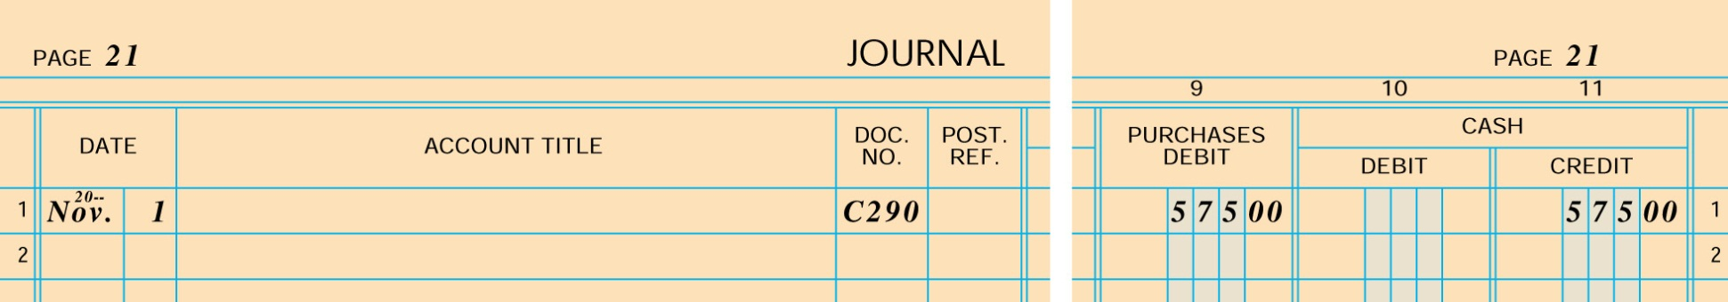
PURCHASING MERCHANDISE FOR CASH
1
6
3
✓
✓
2
4
5
1. Write the date.
2. Place a check mark in the Account Title column to show that no account title is needed.
3. Write the check number.
4. Place a check mark in the Post. Ref. column to show that amounts are not to be posted individually.
5. Write the debit amount.
6. Write the credit amount.
Lesson 10-1, page 231

Slide 30
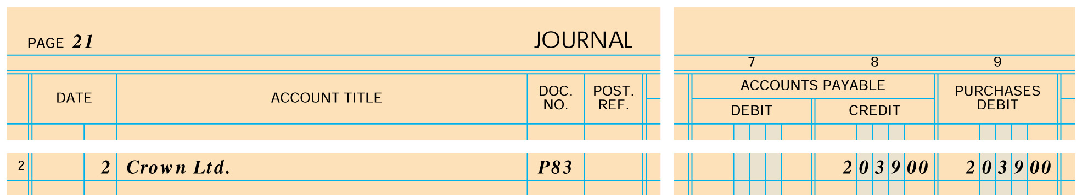
PURCHASING MERCHANDISE ON ACCOUNT
2
1
3
4
5
1. Write the date.
2. Write the vendor name in the Account Title column.
3. Write the purchase invoice number in the Doc. No. column.
4. Write the credit amount.
5. Write the debit amount.
Lesson 10-2, page 234

Slide 31
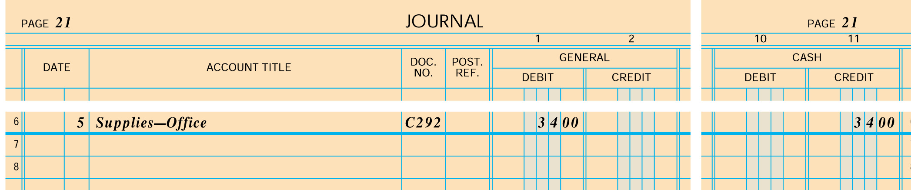
BUYING SUPPLIES FOR CASH
2
1
3
4
5
1. Write the date.
2. Write the account title.
3. Write the check number.
4. Write the debit amount.
5. Write the credit amount.
Lesson 10-2, page 235

Slide 32
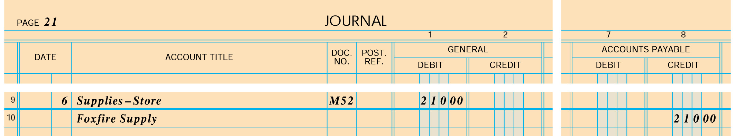
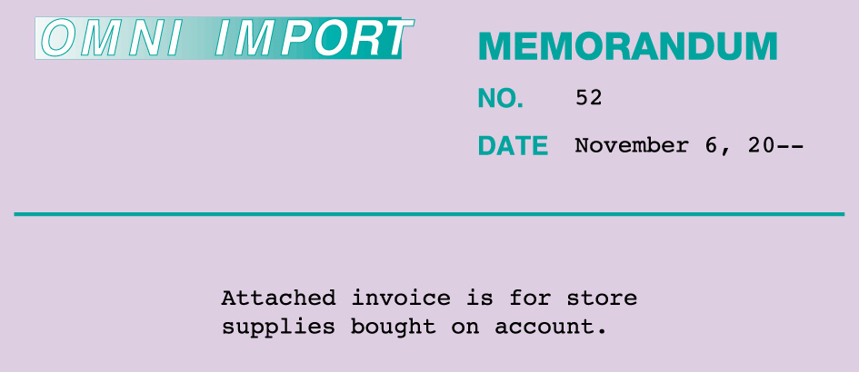
BUYING SUPPLIES ON ACCOUNT
2
1
3
6
4
5
1. Write the date.
2. Write the account title.
3. Write the memorandum number.
4. Write the debit amount.
5. Write the vendor name.
6. Write the credit amount.
Lesson 10-2, page 236

Slide 33
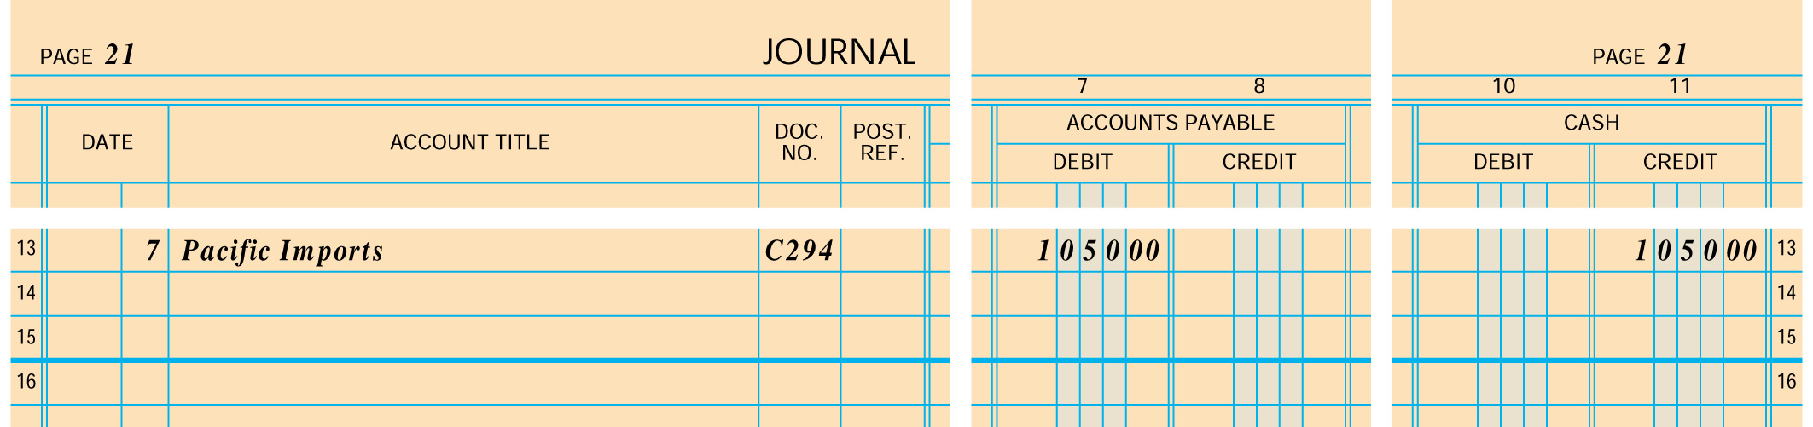
CASH PAYMENT ON ACCOUNT
2
1
3
4
5
1. Write the date.
2. Write the vendor name.
3. Write the check number.
4. Write the debit amount.
5. Write the credit amount.
Lesson 10-3, page 238

Slide 34
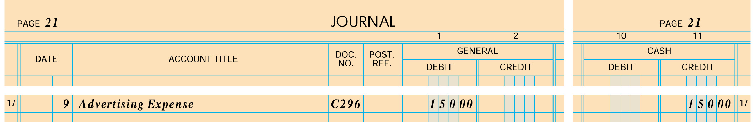
CASH PAYMENT OF AN EXPENSE
2
1
3
4
5
1. Write the date.
2. Write the vendor name account title.
3. Write the check number.
4. Write the debit amount.
5. Write the credit amount.
Lesson 10-3, page 239

Slide 35
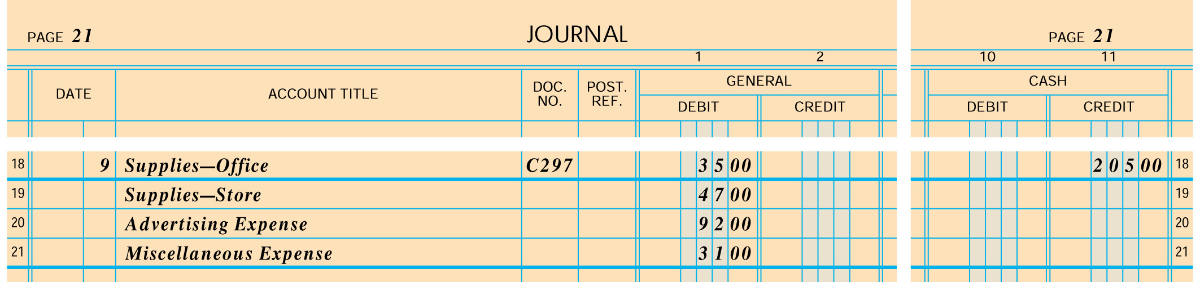
CASH PAYMENT TO REPLENISH PETTY CASH
2
1
3
5
4
1. Write the date.
2. Write the titles of accounts for which petty cash was used.
3. Write the check number.
4. Write the debit amounts.
5. Write the credit amount.
Lesson 10-3, page 240

Slide 36
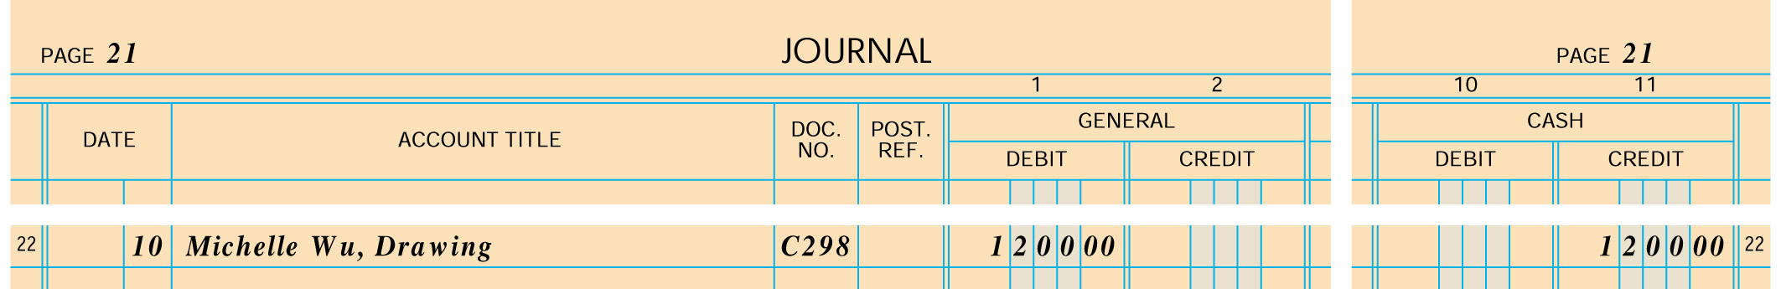
CASH WITHDRAWALS BY PARTNERS
2
1
3
4
5
1. Write the date.
2. Write the account title.
3. Write the check number.
4. Write the debit amount.
5. Write the credit amount.
Lesson 10-3, page 241

Slide 37
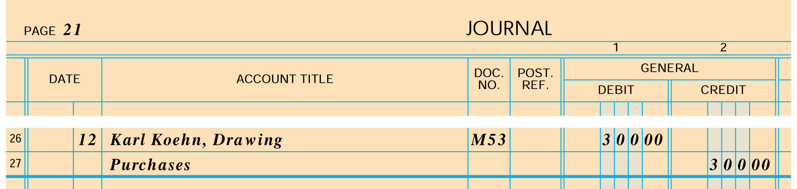
MERCHANDISE WITHDRAWALS BY PARTNERS
2
1
3
4
5
6
1. Write the date.
2. Write the account title Karl Koehn, Drawing.
3. Write the memorandum number.
4. Write the debit amount.
5. Write the account title Purchases.
6. Write the credit amount.
Lesson 10-3, page 242

Slide 38

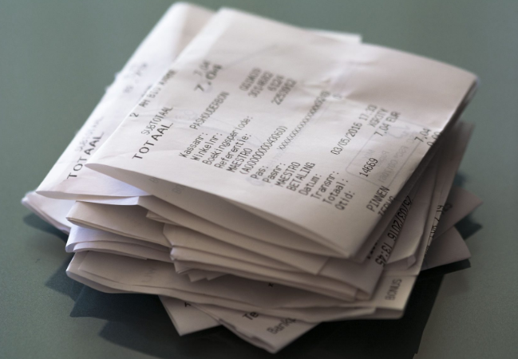
CHAPTER 11
Journalizing Sales and Cash Receipts

Slide 39
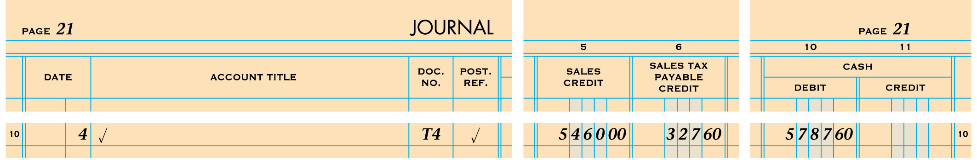
CASH AND CREDIT CARD SALES
1
2
3
4
5
6
7
1. Write the date.
2. Place a check mark in the Account Title column to show that no account title needs to be written.
3. Write the cash register tape number.
4. Place a check mark in the Post. Ref. column to show that amounts on this line are not to be posted individually.
5. Write the sales amount.
6. Write the sales tax amount.
7. Write the cash amount.
Lesson 11-1, page 255

Slide 40
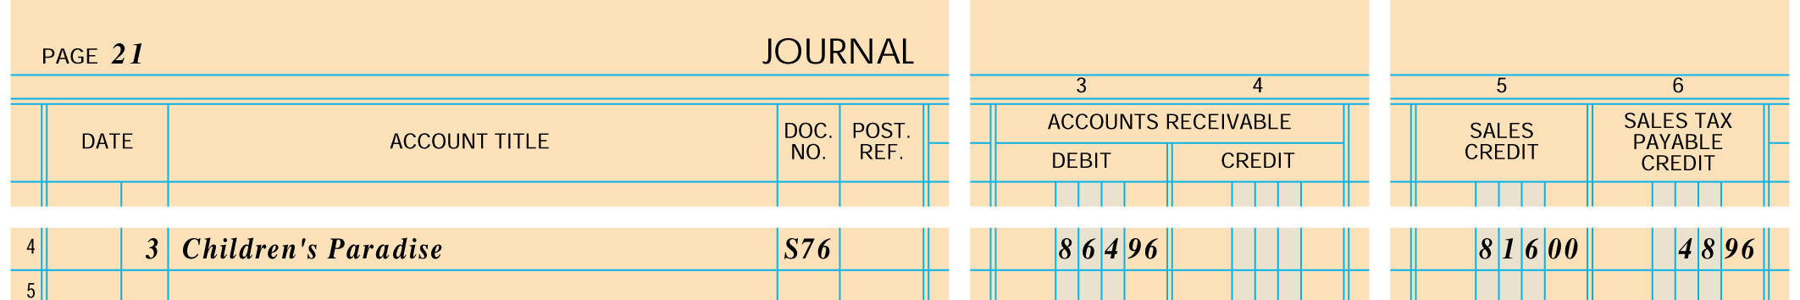
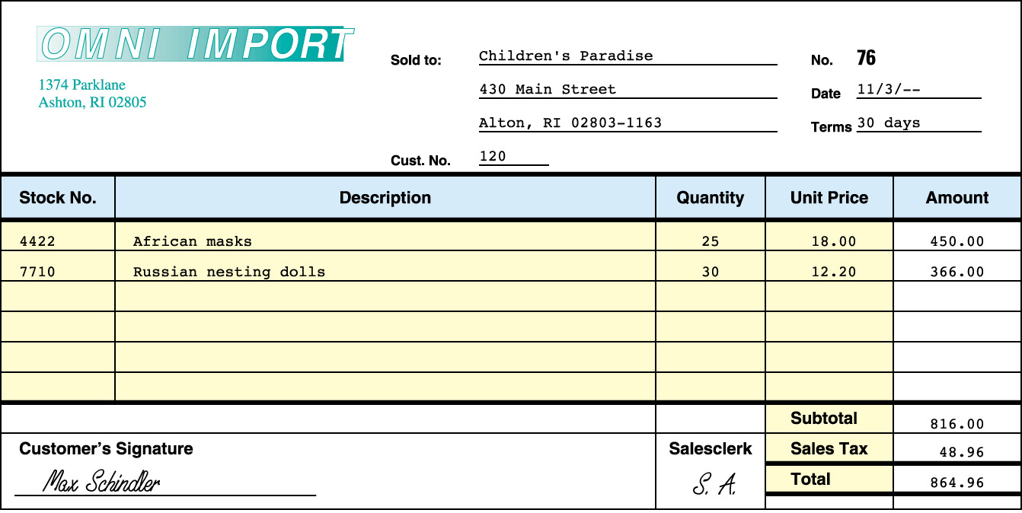
SALES ON ACCOUNT
2
3
4
5
6
1
1. Write the date.
4. Write the total amount owed.
2. Write the customer name.
5. Write the sales amount.
3. Write the sales invoice number.
6. Write the sales tax amount.
Lesson 11-1, page 257

Slide 41
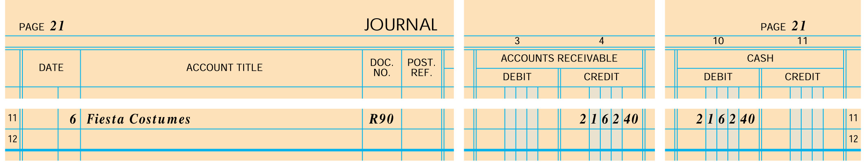
CASH RECEIPTS ON ACCOUNT
1
2
3
4
5
1. Write the date.
2. Write the customer’s name.
3. Write the receipt number.
4. Write the credit amount.
5. Write the debit amount.
Lesson 11-1, page 258

Slide 42
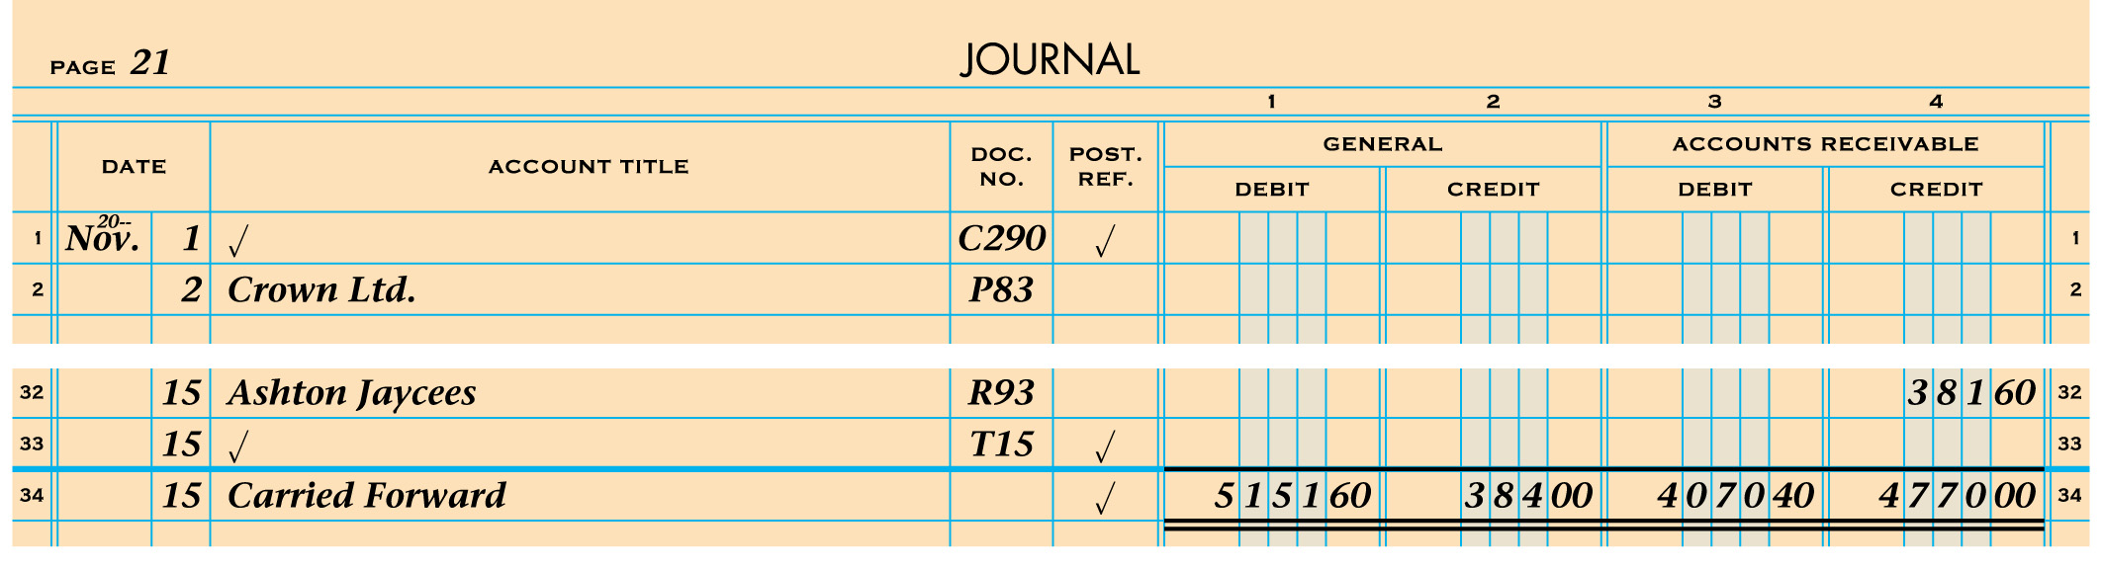
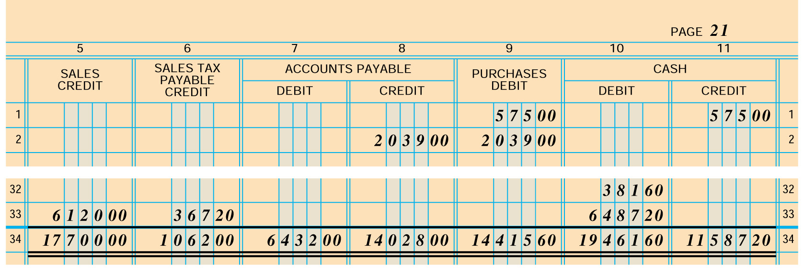
CARRYING TOTALS FORWARD ON THE LEFT PAGE
1
6
2
3
4
5
1. Rule a single line.
2. Write the date.
RIGHT PAGE
3. Write Carried Forward.
4. Place a check mark.
Lesson 11-2, p. 260-261
5. Write each column total.
6. Rule double lines.
5

Slide 43
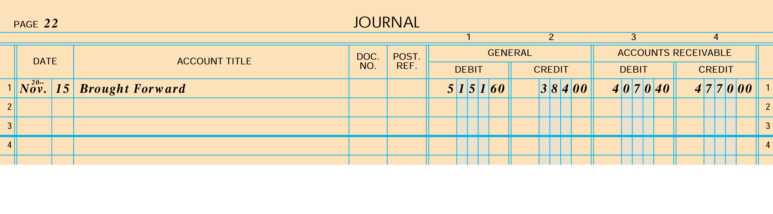
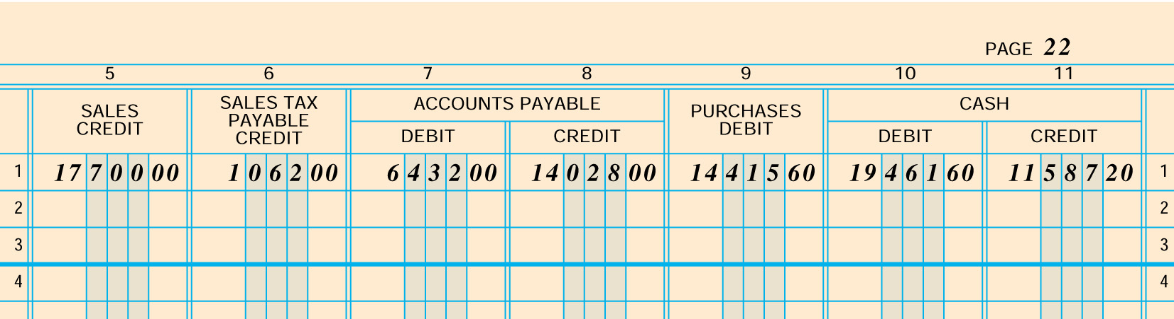
STARTING A NEW EXPANDED JOURNAL LEFT PAGE
1
✓
2
3
4
5
1. Write journal page number on the left and right pages.
2. Write the date.
3. Write Brought Forward.
RIGHT PAGE
4. Place a check mark.
5. Record column total brought forward.
1
Lesson 11-2, p. 262-263
5

Slide 44
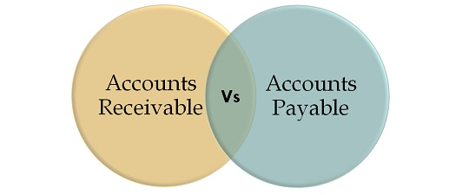
CHAPTER 12
Posting to General and Subsidiary Ledgers

Slide 45
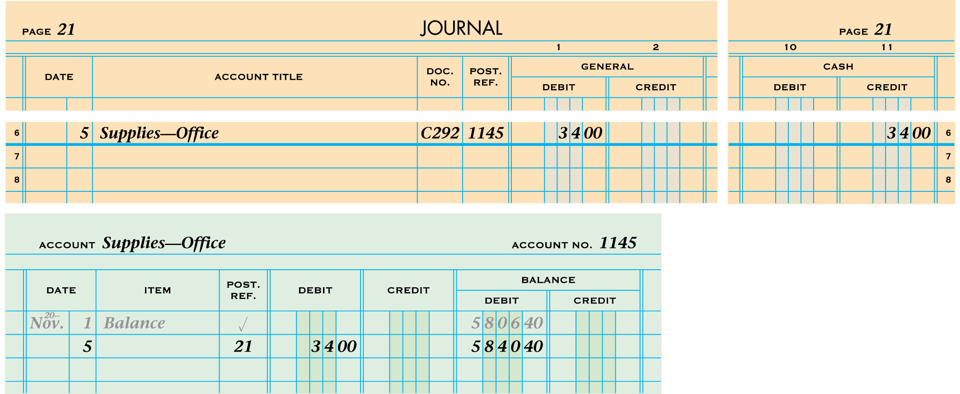
POSTING A JOURNAL’S GENERAL AMOUNT COLUMNS
1
2
5
3
4
1. Write the date.
2. Write the journal page number.
3. Write the debit amount.
4. Calculate and write the new account balance.
5. Write the general ledger account number in the Post. Ref. column of the journal.
Lesson 12-1, page 276

Slide 46
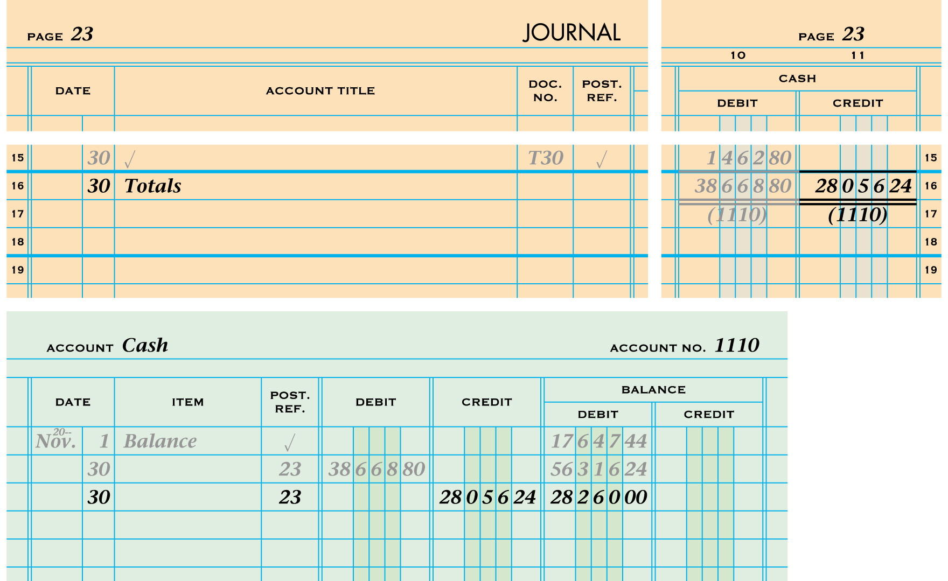
POSTING A JOURNAL’S SPECIAL AMOUNT COLUMNS
2
1
5
3
1. Write the date.
4
2. Write the journal page number.
3. Write the Cash Credit column total.
4. Calculate and write the new account balance.
5. Return to the journal and write the general ledger account number in parentheses below the Cash Credit column total.
Lesson 12-1, page 277

Slide 47
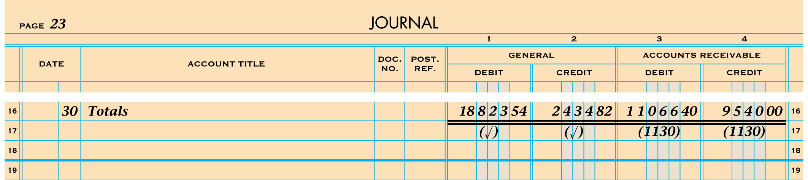
RULES FOR POSTING A JOURNAL’S COLUMN TOTALS
General amount column totals ARE NOT posted
Special amount column totals ARE posted
Lesson 12-1, page 278

Slide 48
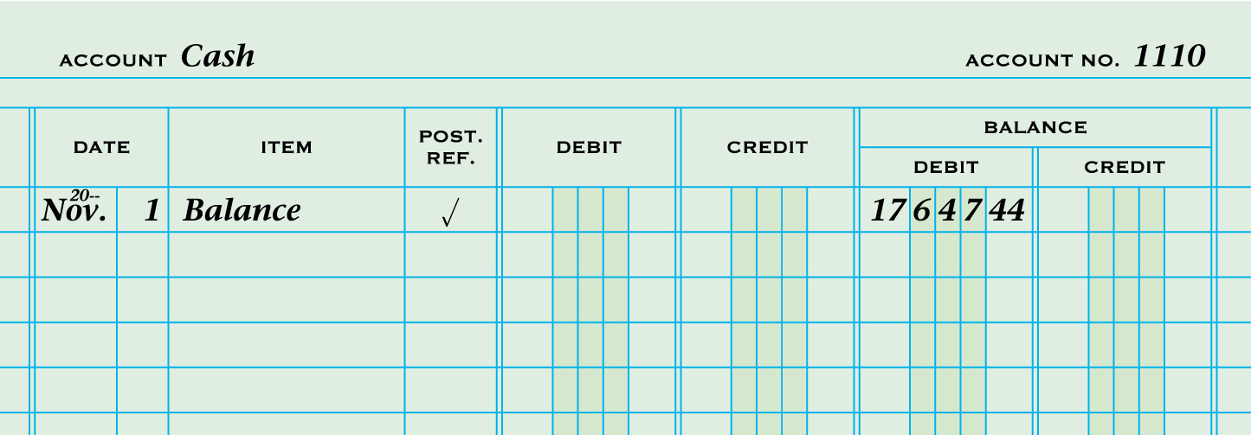
STARTING A NEW PAGE FOR AN ACCOUNT IN A GENERAL LEDGER
1
2
3
4
5
6
1. Write the account title.
2. Write the account number.
3. Write the date.
4. Write Balance.
5. Place a check mark in the Post. Ref. column.
6. Write the account balance.
Lesson 12-1, page 278

Slide 49
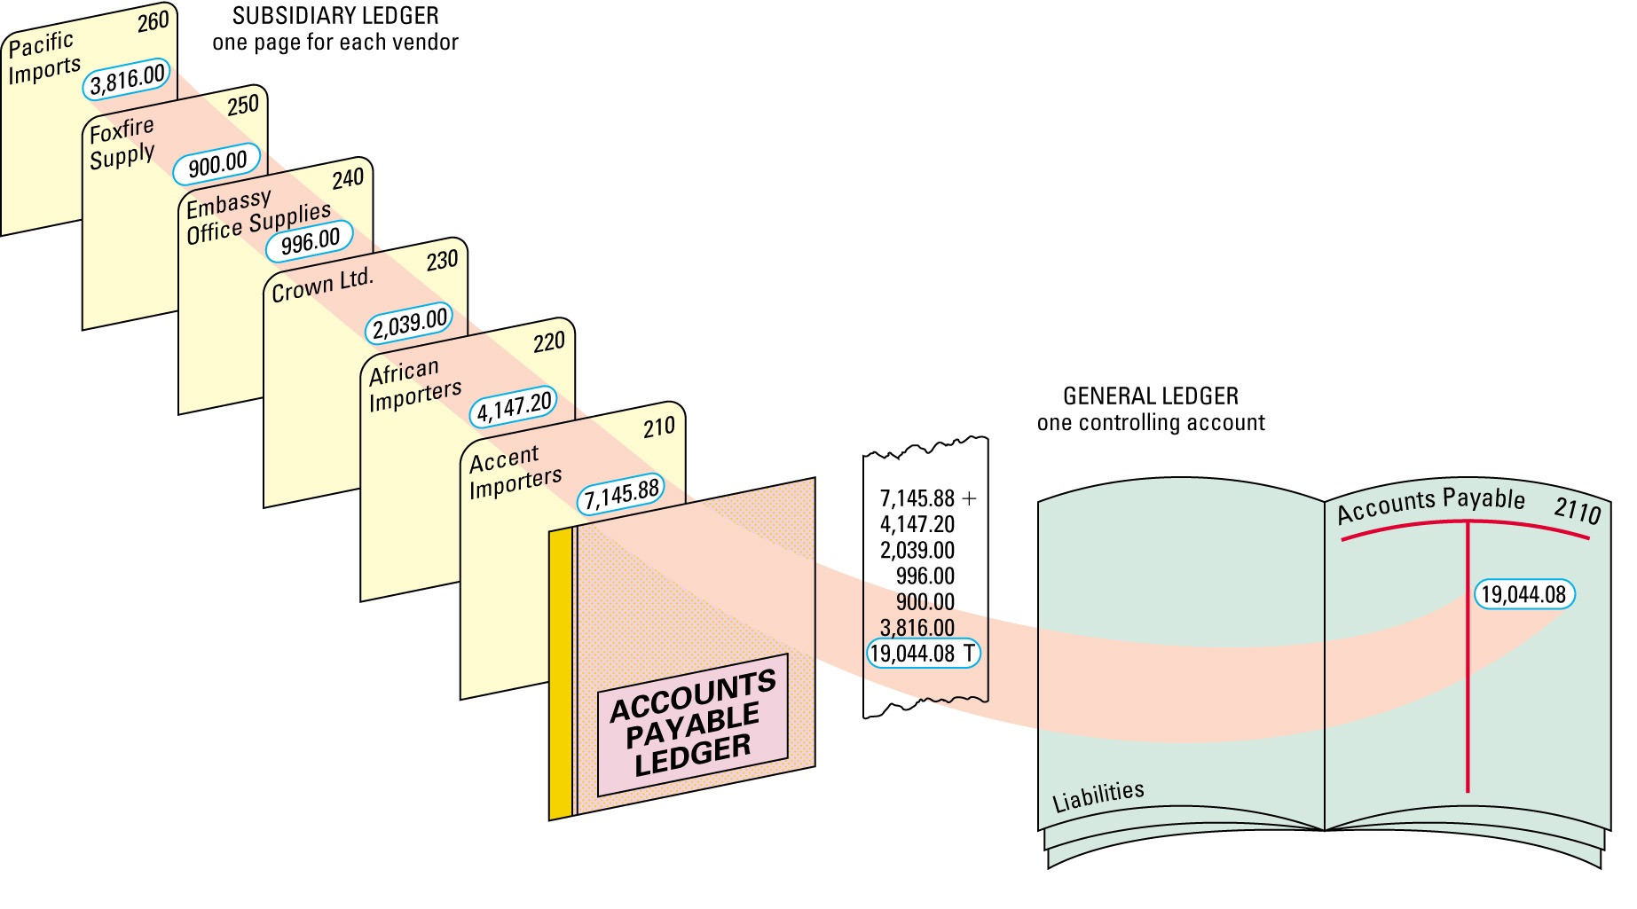
ACCOUNTS PAYABLE LEDGER AND GENERAL LEDGER CONTROLLING ACCOUNT
Lesson 12-2, page 280

Slide 50
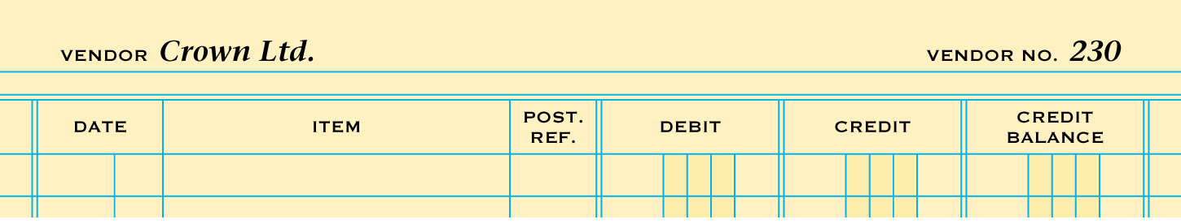
OPENING ACCOUNTS PAYABLE LEDGER FORMS
1. Vendor Name
2. Vendor Number
1
2
Lesson 12-2, page 281

Slide 51
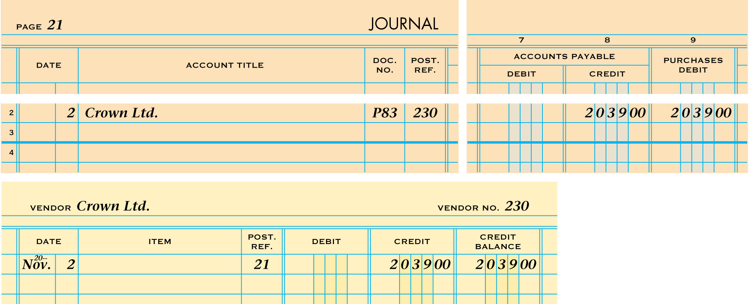
POSTING A CREDIT TO AN ACCOUNTS PAYABLE LEDGER
1
2
5
3
4
1. Write the date.
2. Write the journal page number.
3. Write the credit amount.
4. Calculate and write the new account balance.
5. Write the vendor number.
Lesson 12-2, page 282

Slide 52
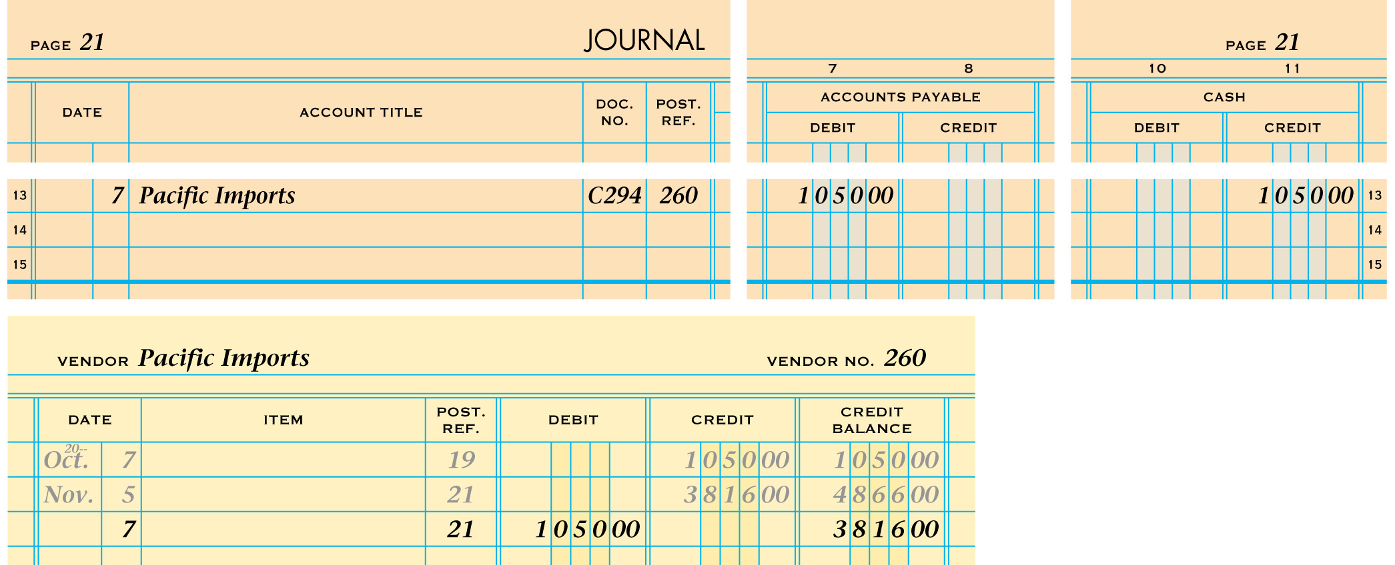
POSTING A DEBIT TO AN ACCOUNTS PAYABLE LEDGER
1
2
5
3
1. Write the date.
4
2. Write the journal page number.
3. Write the debit amount.
4. Calculate and write the new account balance.
5. Write the vendor number.
Lesson 12-2, page 283

Slide 53
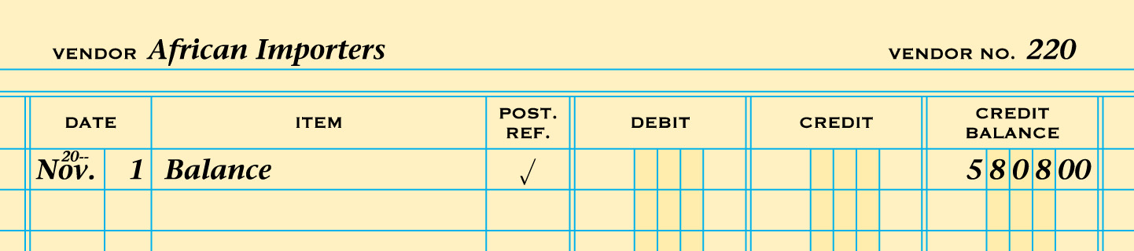
STARTING A NEW PAGE FOR A VENDOR IN AN ACCOUNTS PAYABLE LEDGER
1
2
3
4
5
6
1. Write the vendor name.
2. Write the vendor number.
3. Write the date.
4. Write Balance.
5. Place a check mark in the Post. Ref. column.
6. Write the account balance.
Lesson 12-2, page 283

Slide 54
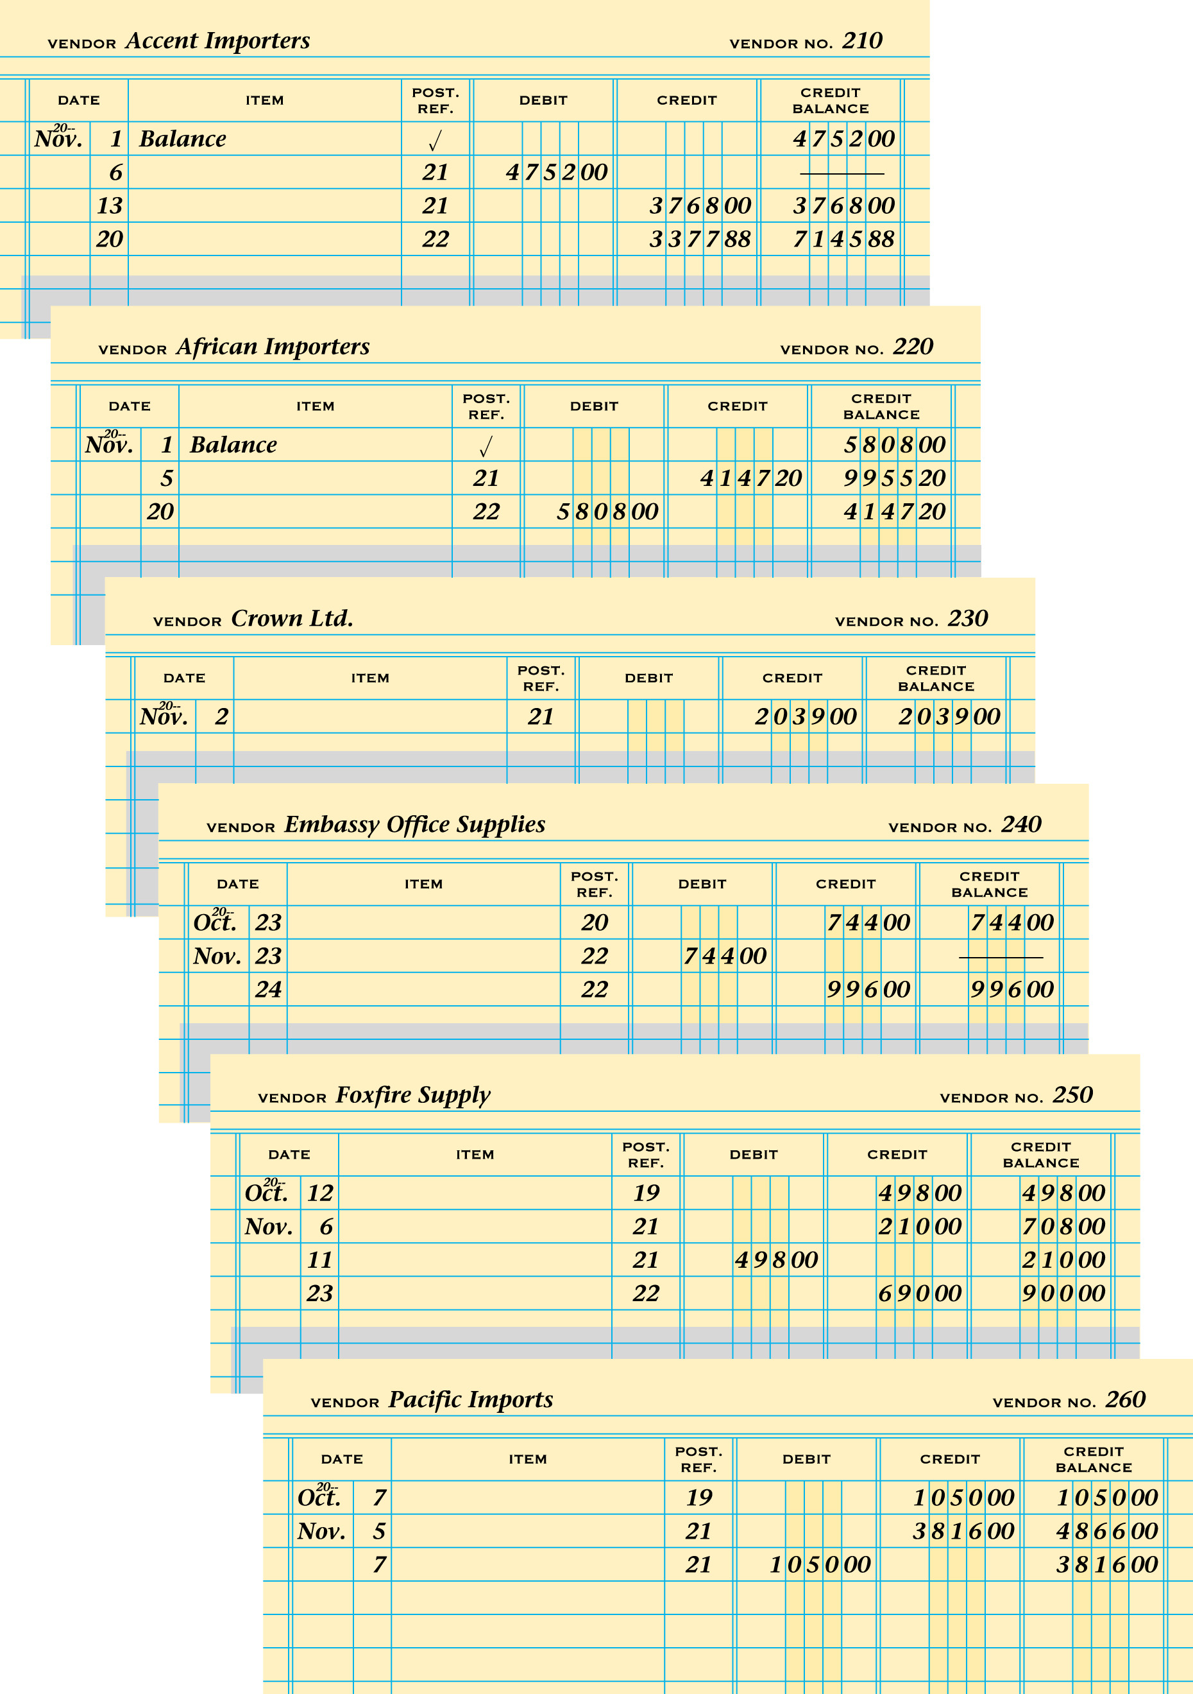
COMPLETED ACCOUNTS PAYABLE LEDGER
Lesson 12-2, page 284

Slide 55
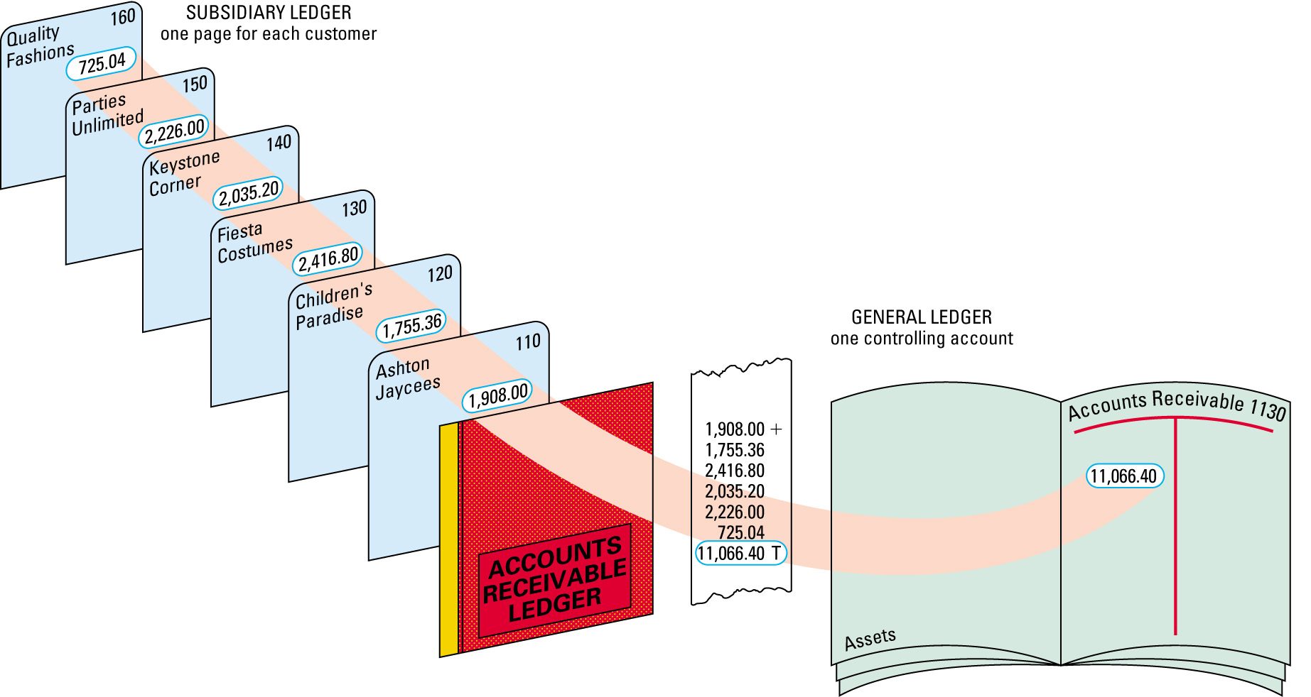
ACCOUNTS RECEIVABLE LEDGER AND GENERAL LEDGER CONTROLLING ACCOUNT
Lesson 12-3, page 286

Slide 56
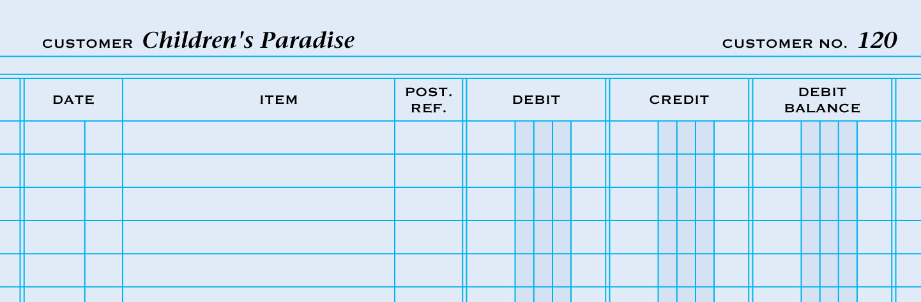
OPENING ACCOUNTS RECEIVABLE LEDGER FORMS
1. Customer Name
2. Customer Number
1
2
Lesson 12-3, page 287

Slide 57
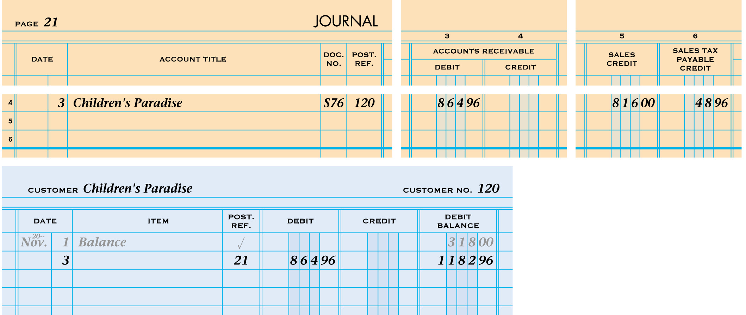
POSTING A DEBIT TO AN ACCOUNTS RECEIVABLE LEDGER
1
2
5
3
4
1. Write the date.
2. Write the journal page number.
3. Write the debit amount.
4. Calculate and write the new account balance.
5. Write the customer number.
Lesson 12-3, page 288

Slide 58
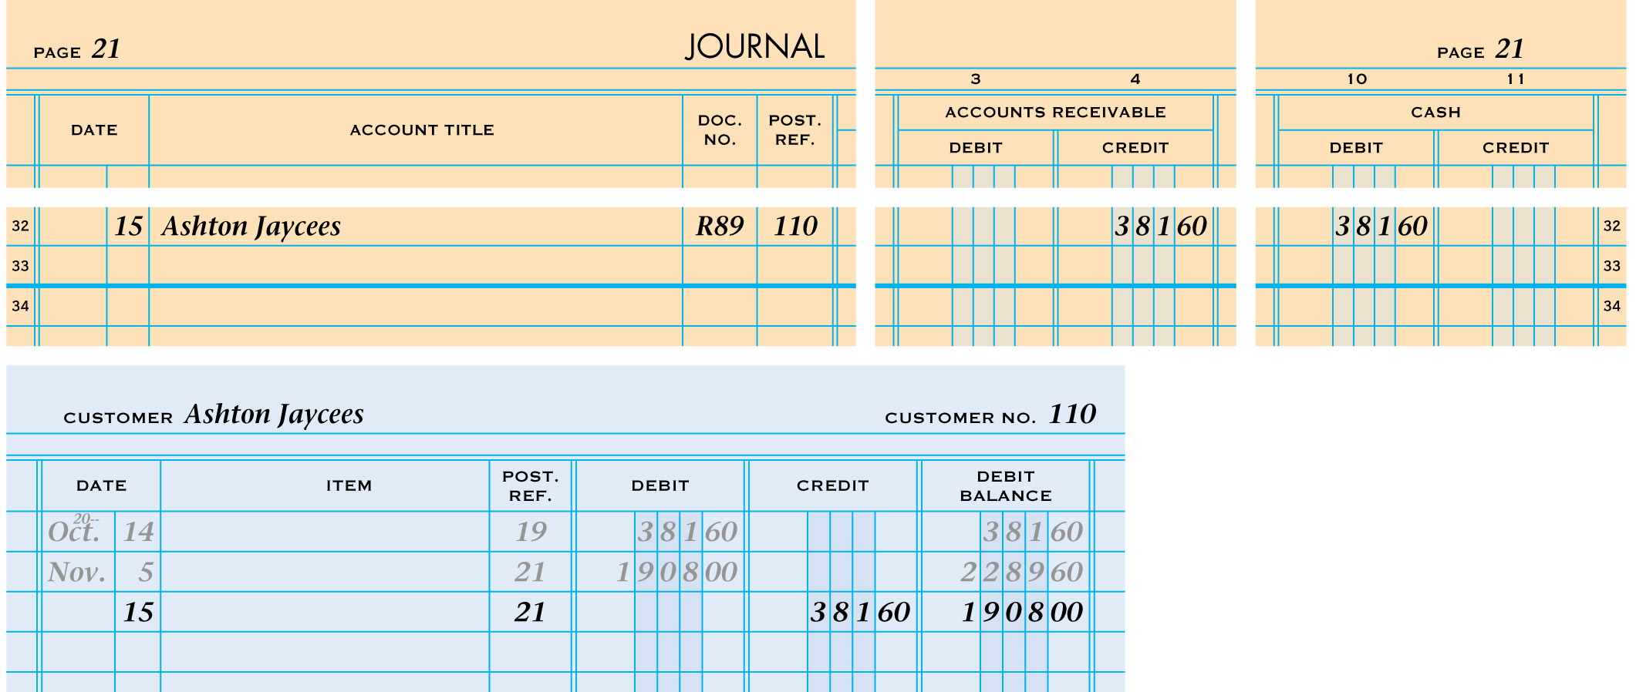
POSTING A CREDIT TO AN ACCOUNTS RECEIVABLE LEDGER
1
5
2
3
1. Write the date.
4
2. Write the journal page number.
3. Write the credit amount.
4. Calculate and write the new account balance.
5. Write the customer number.
Lesson 12-3, page 289

Slide 59

COMPLETED ACCOUNTS RECEIVABLE LEDGER
Lesson 12-3, page 290

Slide 60

PROVING THE ACCOUNTS PAYABLE LEDGER
Lesson 12-4, page 292

Slide 61

PROVING THE ACCOUNTS RECEIVABLE LEDGER
Lesson 12-4, page 293

Slide 62

CHAPTER 13
Preparing Payroll Records

Slide 63

CALCULATING EMPLOYEE HOURS WORKED
1. Calculate regular hours.
2. Calculate overtime hours.
3. Add Hours Reg and Hours OT columns and enter totals.
4. Add Hours column.
1
2
3
4
Lesson 13-1, page 305

Slide 64

CALCULATING EMPLOYEE TOTAL EARNINGS
1. Enter the rate for regular time.
2. Calculate regular earnings.
3. Enter the rate for overtime.
4. Calculate overtime earnings.
5. Calculate total earnings.
1
2
3
4
5
Lesson 13-1, page 306

Slide 65

EMPLOYEE’S WITHHOLDING ALLOWANCE CERTIFICATE
2
1
3
4
5
1. Name and Address
4. Withholding Allowances
2. Social Security Number
5. Signature and Date
3. Marital Status
Lesson 13-2, page 309

Slide 66

EMPLOYEE’S INCOME TAX WITHHOLDING—SINGLE PERSONS
At least But Less than
1,120 1,140
3
87
2
Lesson 13-2, page 310

Slide 67
EMPLOYEE SOCIAL SECURITY AND MEDICARE TAX
+
−
Calculate Social Security Tax Deduction
÷
×
Total Social Security Social Security
Earnings × Tax Rate = Tax Deduction
$1,137.00 × 6.5% = $73.91
+
−
Calculate Medicare Tax Deduction
÷
×
Total Medicare Medicare
Earnings × Tax Rate = Tax Deduction
$1,137.00 × 1.5% = $17.06
Lesson 13-2, page 312

Slide 68

PAYROLL REGISTER
1
2
4
5
6
7
8
9
10
11
13
3
12
1. Pay Period Date
8. Health Insurance
2. Payment Date
9. Other Deductions
3. Employee Personal Data
10. Total Deductions
4. Earnings
11. Net Pay
5. Federal Income Tax
12. Total, Prove, and Rule
6. Social Security Tax
13. Check Number
Lesson 13-3, page 314
7. Medicare Tax

Slide 69

EMPLOYEE EARNINGS RECORDS
5. Earnings, Deductions, Net Pay
1. Last day of Quarter
2. Employee Personal Data
1
3. Beginning Accumulated Earnings
5
2
3
4. Pay Period
4
6
7
6. Updated Accumulated Earnings
7. Total and Prove
Lesson 13-3, page 316

Slide 70

PAYROLL BANK ACCOUNT
1
2
1. Prepare the check stub.
2. Prepare the check.
Lesson 13-4, page 319

Slide 71

CHAPTER 14
Payroll Accounting Taxes, and Reports

Slide 72

PAYROLL REGISTER
Lesson 14-1, page 332

Slide 73

ANALYZING PAYMENT OF PAYROLL
Lesson 14-1, page 333

Slide 74

JOURNALIZING PAYMENT OF A PAYROLL
4
2
5
1
3
6
7
1. Write the date.
2. Write the title of the account debited.
3. Write the check number.
4. Write the amount debited to Salary Expense.
5. Write the amount credited to Cash.
6. Write the titles of the accounts credited.
7. Write the credit amounts.
Lesson 14-1, page 334

Slide 75
Recording Employer Payroll Taxes
Omni has withheld from each employee
  Federal income tax
  Social security tax
  Medicare tax
The amounts withheld are liabilities to the business until they are actually paid to the government.
In addition, employers must pay several of their own payroll taxes. Employer payroll taxes are expenses.
  Employer social security tax
  Medicare tax
  Federal unemployment tax
  State unemployment tax
    Employer payroll taxes expense is based on a percentage of employee earnings.
Social security and Medicare taxes are the only payroll taxes paid by BOTH the employees and employer .
Congress sets the social security

Slide 76

UNEMPLOYMENT TAXABLE EARNINGS
2
1
1
3
1. Enter accumulated earnings and total earnings for each employee.
2. Enter unemployment taxable earnings.
3. Total the unemployment taxable earnings column.
Lesson 14-2, page 337

Slide 77
UNEMPLOYMENT TAXES
+
−
Calculate Unemployment Taxes—Federal
÷
×
Unemployment Federal Federal
Taxable Unemployment Unemployment
Earnings × Tax Rate = Tax
$183.75 × 0.8% = $1.47
+
−
Calculate Unemployment Taxes—State
÷
×
Unemployment State State
Taxable Unemployment Unemployment
Earnings × Tax Rate = Tax
$183.75 × 5.4% = $9.92
Lesson 14-2, page 338

Slide 78

JOURNALIZING EMPLOYER PAYROLL TAXES
2
3
4
1
6
5
1. Write the date.
2. Write the expense account debited.
3. Write the memorandum number.
4. Write the debit amount.
5. Write the titles of the liability accounts credited.
6. Write the credit amounts.
Lesson 14-2, page 339

Slide 79

EMPLOYER ANNUAL REPORT TO EMPLOYEES OF TAXES WITHHELD
Lesson 14-3, page 341

Slide 80
PREPARING EMPLOYER’S QUARTERLY FEDERAL TAX RETURN
+
−
Calculate Social Security and Medicare Taxes
÷
×
Total Earnings × Tax Rate = Tax
Social Security $22,575.00 × 13% = $2,934.75
Medicare $22,575.00 3% = $ 677.25
+
−
Calculate Social Security and Medicare Taxes
÷
×
Employee Employer
Social Social
Federal Income Security and Security and Federal Tax
Tax Withheld + Medicare Tax + Medicare Tax = Liability
Dec. 1-15 $273.00 + $304.33 + $304.33 = 881.66
Dec. 16-31 $269.00 + 302.08 + $302.08 = $873.16
Totals $542.00 + 606.41 + 606.41 = $1,754.82
Lesson 14-3, page 343

Slide 81

EMPLOYER ANNUAL REPORTING OF PAYROLL TAXES
Lesson 14-3, page 344

Slide 82

JOURNALIZING PAYMENT OF LIABILITY FOR EMPLOYEE INCOME TAX, SOCIAL SECURITY TAX, AND MEDICARE TAX
1
3
5
4
2
1. Write the date.
2. Write the title of the three accounts debited.
3. Write the check number.
4. Write the three debit amounts.
5. Write the amount of the credit to Cash.
Lesson 14-4, page 348

Slide 83

JOURNALIZING PAYMENT OF LIABILITY FOR FEDERAL UNEMPLOYMENT TAX
1
2
3
4
5
1. Write the date.
2. Write the title of the account debited.
3. Write the check number.
4. Write the debit amount.
5. Write the amount of the credit to Cash.
Lesson 14-4, page 350

Slide 84

JOURNALIZING PAYMENT OF LIABILITY FOR STATE UNEMPLOYMENT TAX
1
2
3
4
5
1. Write the date.
2. Write the title of the account debited.
3. Write the check number.
4. Write the debit amount.
5. Write the amount of the credit to Cash.
Lesson 14-4, page 350

Slide 85

CHAPTER 15
Work Sheet for a Merchandising Business

Slide 86

TRANSFERRING GENERAL LEDGER ACCOUNT BALANCES TO A WORK SHEET
RECORDING A TRIAL BALANCE ON A WORK SHEET
1
2
1. Write the titles of the general ledger accounts.
2. Write the balance of each account.
1
2
3. Total, prove, and rule the debit and credit columns.
3
Lesson 15-1, page 366-368

Slide 87

RECORDING A MERCHANDISE INVENTORY ADJUSTMENT
3
2
1
1. Write the debit amount.
2. Write the credit amount.
3. Label the two parts of this adjustment.
Lesson 15-1, page 370

Slide 88

RECORDING A PREPAID INSURANCE ADJUSTMENT
3
2
3
1
1. Write the debit amount.
2. Write the credit amount.
3. Label the two parts of this adjustment.
Lesson 15-2, page 376

Slide 89

COMPLETING AN 8-COLUMN WORK SHEET
2
1
1. Extend balance sheet items to Balance Sheet columns.
2. Extend income statement items to Income Statement columns.
3. Total Income Statement and Balance Sheet columns.
4. Calculate net income or net loss.
5. Extend net income or net loss to Balance Sheet Debit or Credit column.
6. Total Income Statement and Balance Sheet columns.
7. Check that totals are in balance.
3
4
5
6
7
Lesson 15-3, page 378

Slide 90

A 10-COLUMN WORK SHEET FOR A MERCHANDISING BUSINESS (LEFT PAGE)
1. Record the trial balance.
2. Plan the adjustments.
1
2
Lesson 15-3, page 382

Slide 91
A 10-COLUMN WORK SHEET FOR A MERCHANDISING BUSINESS
3. Extend the balances in the Trial Balance columns to the Adjusted Trial Balance columns.
3
5
4. Total, prove, and rule the Adjusted Trial Balance columns.
5. Extend the amounts in the Adjusted Trial Balance columns to the appropriate Income Statement and Balance Sheet columns.
6. Total, prove, and rule the appropriate Income Statement and Balance Sheet columns.
4
6
Lesson 15-3, page 383

Slide 92

CHAPTER 16
Financial Statements for a Partnership

Slide 93

INCOME STATEMENT INFORMATION ON A WORK SHEET
Copy to Income Statement
Lesson 16-1, page 392

Slide 94
FIRST TWO SECTIONS OF AN INCOME STATEMENT FOR A MERCHANDISING BUSINESS
1
2
3
1. Write the income statement heading on three lines.
2. Prepare the revenue section.
3. Prepare the merchandise sold section.
Lesson 16-1, page 393

Slide 95

COMPLETING AN INCOME STATEMENT FOR A MERCHANDISING BUSINESS
8
4. Calculate the gross profit on sales.
5. Prepare the expenses section.
6. Calculate the net income.
4
7. Rule double lines.
8. Calculate the component percentages.
5
6
7
Lesson 16-1, page 394

Slide 96

PREPARING A DISTRIBUTION OF NET INCOME STATEMENT
1
2
3
4
5
6
7
8
1. Heading
5. Second Partner’s Share of Net Income
2. First Partner’s Name
3. First Partner’s Share of Net Income
6. Net Income
7. Total Net Income
4. Second Partner’s Name
8. Double Lines
Lesson 16-3, page 402

Slide 97

DISTRIBUTION OF NET INCOME STATEMENT WITH UNEQUAL DISTRIBUTION OF EARNINGS
Lesson 16-3, page 403

Slide 98

OWNERS’ EQUITY STATEMENT
1
2
3
4
5
6
7
1. Heading
5. Second Partner’s Ending Capital
2. First Partner’s Name
3. First Partner’s Ending Capital
6. Total Owners’ Equity
7. Double Lines
Lesson 16-3, page 405
4. Second Partner’s Name

Slide 99

OWNERS’ EQUITY STATEMENT WITH AN ADDITIONAL INVESTMENT AND A NET LOSS
Lesson 16-3, page 406

Slide 100

BALANCE SHEET INFORMATION ON A WORK SHEET
Lesson 16-4, page 408

Slide 101

COMPLETING A BALANCE SHEET FOR A MERCHANDISING BUSINESS
4. Prepare the owners’ equity section.
5. Total the liabilities and owners’ equity sections.
6. Verify the accuracy by comparing totals.
7
7. Rule double lines.
6
4
5
7
Lesson 16-4, page 410

Slide 102

HEADING OF AN INCOME STATEMENT
1
2
3
1. Name of Company
2. Name of Report
3. Date of Report
Lesson 8-1, page 182

Slide 103

HEADING OF A BALANCE SHEET
1
2
3
1. Name of Company
2. Name of Report
3. Date of Report
Lesson 8-2, page 187

Slide 104
Chapter Vocabulary
Chapter 9
Adjusting entries
Permanent accounts
Temporary accounts
Closing entries
Post-closing trial balance
Accounting cycle

Slide 105
Chapter Vocabulary
Chapter 10
Partnership partner
Merchandising business
Retail merchandising business
Merchandise
Wholesale merchandising business
Mark up
Vendor
Purchase invoice
Terms of sale

Slide 106
Chapter Vocabulary
Chapter 12
Subsidiary ledger
Accounts payable ledger
Accounts receivable ledger
Controlling account
Schedule of accounts payable
Schedule of accounts receivable
Chapter 11
Customer
Sales tax
Cash sale
Credit card sale

Slide 107
Chapter 13
Chapter Vocabulary
Salary
Pay period
Payroll
Total earnings
Payroll taxes
Withholding allowance
Social security tax
Medicare tax
Tax base
Payroll register
Net pay
Employee earnings record
Gross Pay

Slide 108
Chapter Vocabulary
Chapter 15
Inventory
Merchandise inventory
Chapter 14
Federal unemployment tax
State unemployment tax

